Slide 1
THEORY – 5 ENVIRONMENTAL STUDIES
3RD SEMESTER, MECHANICAL
Prepared by -
SAROJ KUMAR SAHU,
Lecturer in Mechanical Engineering,
UGMIT, Rayagada.

Slide 2
CHAPTER - 3
SYSTEMS
CONCEPT OF AN
ECOSYSTEMS

Slide 3
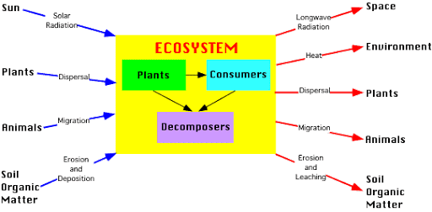
An ecosystem is a community of living organisms in conjunction with the nonliving components of their environment, interacting as a system.
These biotic and abiotic components are linked together through nutrient cycles and energy flows.

Slide 4
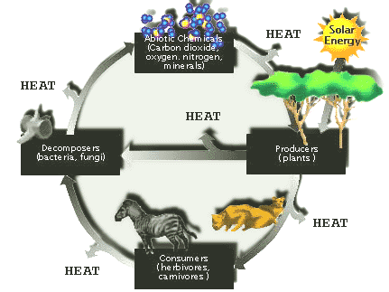

Slide 5
CHARACTERISTICS OF ECOSYSTEM
Ecosystems contain biotic or living, parts, as well as abiotic factors, or nonliving parts.
Biotic factors include plants, animals, and other organisms.
Abiotic factors include rocks, temperature, and humidity.
Every factor in an ecosystem depends on every other factor, either directly or indirectly.

Slide 6
FUNCTIONS OF ECOSYSTEM
Ecosystem functioning reflects the collective life activities of plants, animals, and microbes and the effects these activities (e.g., feeding, growing, moving, excreting waste) have on the physical and chemical conditions of their environment.
It regulates the essential ecological processes, supports life systems and renders stability.
It is also responsible for the cycling of nutrients between biotic and abiotic components.
It maintains a balance among the various trophic levels in the ecosystem.

Slide 7
ECOSYSTEM AND IT’S IMPORTANCE
An interactive stable system or community formed as a result of various organisms interacting with each other and the non-living components of the environment is called an ecosystem.
It is important for ecological processes and regulation of the energy flow, supporting life systems and providing stability.
As a society, we depend on healthy ecosystems to do many things;
to purify the air so we can breathe properly, sequester carbon for climate regulation, cycle nutrients
so we have access to clean drinking water without costly infrastructure, and pollinate our crops so we don't go hungry.

Slide 8
TYPES OF THE ECOSYSTEM
An ecosystem consists of all the living and non-living things in a specific natural setting.
The major types of ecosystems are forests, grasslands, deserts, tundra, freshwater and marine.
The different types of the ecosystem include:
Terrestrial ecosystem.
Forest ecosystem.
Grassland ecosystem.
Desert ecosystem.
Tundra ecosystem.
Freshwater ecosystem.
Marine ecosystem.

Slide 65
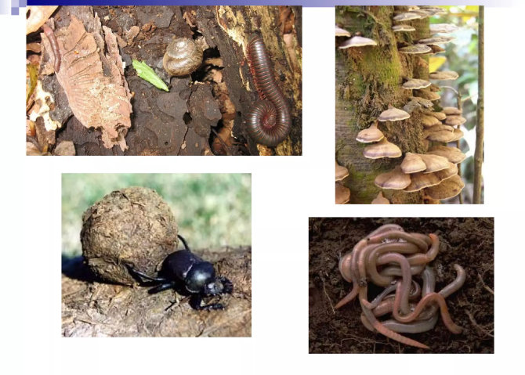

Slide 68
ENERGY FLOW IN ECOSYSTEM

Slide 69
CONTENT
Concept of energy in Ecosystem.
Components of energy flow in Ecosystem.
Ecological energetic.
Laws governing the energy transformation in Ecosystem
Interconnection among organisms.
The ten percent (10 %) Law.
Representation of energy flow in Ecosystem.
Conclusion

Slide 90
Syllabus
Concept of an ecosystem
Structure and function of an ecosystem
Producers, consumers and decomposers
Energy flow in the ecosystems
Ecological succession
Food chains, food web sand ecological pyramids
Introduction, types. Characteristic features, structure and function of the following ecosystem.
Forest ecosystem
Aquatic ecosystem (ponds, streams, lakes, rivers, oceans, estuaries)

