Slide 1
THEORY - 1 ENTREPRENEURSHIP and MANAGEMENT & SMART TECHNOLOGY
5TH SEMESTER, MECHANICAL
Prepared by :-
SAROJ KUMAR SAHU
Lecturer in Mechanical Engineering
U.G.M.I.T., Rayagada

Slide 2
Chapter – 4 MANAGEMENT PRINCIPLES
TOPIC TO BE COVERED :-
Definition of management
Principles of management
Functions of management
I. Planning
II. Organising
III. Staffing
IV. Directing
V. Controlling
Level of management in an organization

Slide 3
DEFINITION of MANAGEMENT
Management (or managing) is the administration of an organization, whether it is a business, a non-profit organization, or a government body.
It is the art and science of managing resources of the business.
Management is getting the work done through the efforts of others and effective utilization of human and material resources to achieve the enterprise objectives.

Slide 4
DEFINITION of MANAGEMENT
Management if the art of getting things done by a group of people with the effective utilization of available resources. (Definitions of Management: – According to various experts like Peter F. Drucker, Ralph C. Davis etc.)
Joseph L. Massie: Management is the process by which a cooperative group directs actions towards common goal.
James D. Monny: Management is the art of directing and inspiring the people.

Slide 5
DEFINITION of MANAGEMENT
G.E. Millward: Management is the process and the agency through which execution of policy is planed and supervised.
Management is the process consisting the
functions of : – Planning – Organizing.

Slide 6
DEFINITION of MANAGEMENT
G.R. Terry: "Management is a distinct process consisting of planning, organizing, activating and controlling to determine and accomplish the objectives by the use of people and resources.”
Henry Fayol: "To manage is to forecast and plan, to organise, to command, to co-ordinate and to control.”
Stanley Vance: "Management is simply the process of decision making and control over the action of human beings for the express purpose of attaining pre-determined goals.”

Slide 7
The 4 M’s of Management
Manpower
Machinery
Materials
Money

Slide 9
MANAGEMENT SKILLS
Three basic kinds of skills
Technical Skill - is the ability to use procedures, techniques and knowledge of a specialized field. E.g. surgeon, engineers, accountants.
Human Skill – is the ability to work with, understand, and motivate other people as individuals or in groups.
Conceptual Skill – is the ability to coordinate and integrate the organization goals and activities.

Slide 10
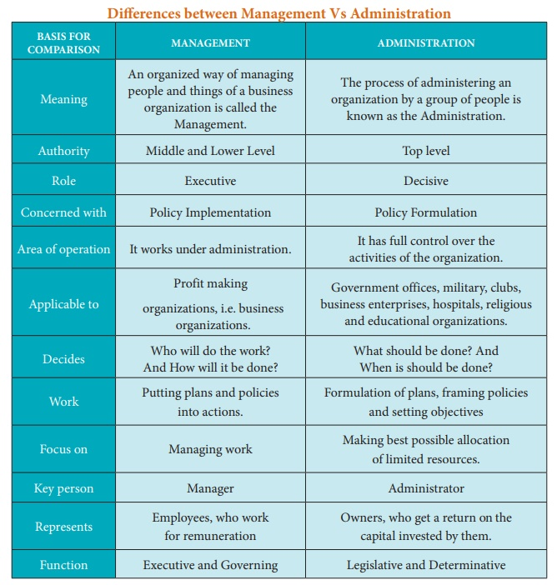

Slide 11
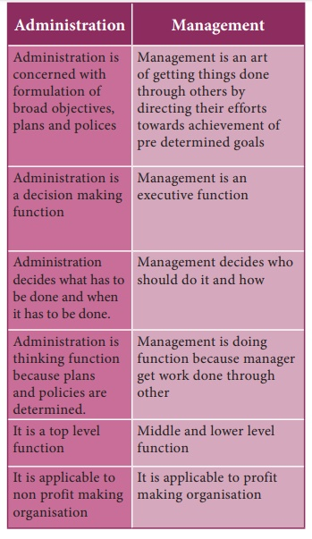

Slide 12
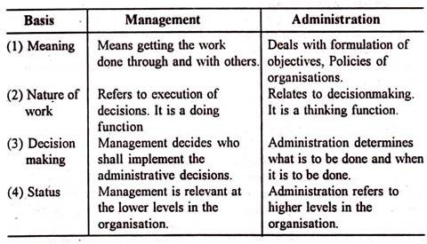

Slide 13
CHARACTERISTICS of MANAGEMENT

Slide 14
CHARACTERISTICS of MANAGEMENT
Art as well as Science
Management is an activity
A continuous Process
Management achieving Pre-defined objectives
Organized Activities
Management is a Factor of Production

Slide 15
CHARACTERISTICS of MANAGEMENT
Management as system of activity
Management is a discipline
Management is a purposeful activity
Management is a distinct entity
Management aims at maximizing profit
Decision making
Management is a profession
Universal Application

Slide 16
CHARACTERISTICS of MANAGEMENT
Management is getting things done
Management as a class of a team
Management as a career
Direction and control
Dynamics
Management is needed at all levels
Leadership activity

Slide 17
MANAGERIAL OBJECTIVES
Efficient use of resources
Customer Satisfaction
Reasonable profits so as to give a fair return on capital invested in business
Survival and continuity of business
Enhancing goodwill or reputation of the enterprise

Slide 18
PRINCIPLES of MANAGEMENT
Division of Work
Authority and Responsibility
Discipline
Unity of Command
Unity of Direction
Subordination of Individual Interest
Remuneration
Centralization

Slide 19
5 FUNCTIONS of MANAGEMENT
Koontz and O'Donnell explained five functions of management.
They have become widely accepted functions of management everywhere.
They are
Planning
Organizing
Staffing
Directing
Controlling

Slide 20
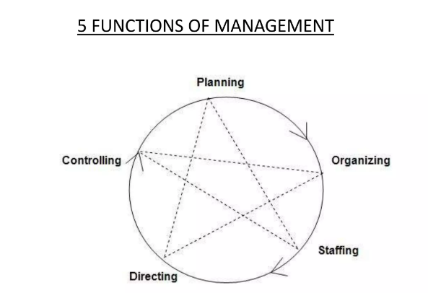
5 FUNCTIONS of MANAGEMENT

Slide 21
FUNCTIONS of MANAGEMENT

Slide 22
FUNCTIONS of MANAGEMENT
1. PLANNING
Planning is deciding in advance :-
what to do
how to do
why to do
where to do and
who will be responsible for doing is planning.
Definition "Planning bridges the gap from where we are to where we want to go. It makes it possible for things to occur which would not otherwise happen" - Koontz and O' Donnel.

Slide 23
FUNCTIONS of MANAGEMENT
1. PLANNING
Importance of Planning :-
Planning provides directions
Planning reduces the risks of uncertainty
Planning reduces overlapping and wasteful activities
Planning promotes innovative ideas
Planning facilitates decision making
Planning establishes standards for controlling
Planning reduces the risks of uncertainty

Slide 24
FUNCTIONS of MANAGEMENT
1. PLANNING
Features of planning:-
Planning focuses on achieving objectives
Planning is a primary function of management
Planning is pervasive
Planning is continuous
Planning is futuristic
Planning involves decision making
Planning is a mental exercise

Slide 25
FUNCTIONS of MANAGEMENT
1. PLANNING
PROCESS OF PLANNING:-
Setting objectives:
Objectives may be set for the entire organization and each department or unit within the organization.
Developing premises:
Planning is concerned with the future which is uncertain and every planner is using conjuncture about what might happen in future.
Identifying alternative courses of action:
Once objectives are set, assumptions are made. Then the next step would be to act upon them.

Slide 26
FUNCTIONS of MANAGEMENT
1. PLANNING
PROCESS OF PLANNING:-
Evaluating alternative courses:
The next step is to weigh the pros and cons of each alternative.
Selecting an alternative:
This is the real point of decision making.
The best plan has to be adopted and implemented.
Implement the plan:
This is concerned with putting the plan into action.
Follow-up action:
Monitoring the plans are equally important to ensure that objectives are achieved.

Slide 27
FUNCTIONS of MANAGEMENT
1. PLANNING
Primary function of Management :-
Defining the organizational purpose and ways to achieve it.
Specifying the goals to be achieved and deciding in advance the appropriate actions taken to achieve those goals.
delivering strategic value
- planning function for the new era.
A dynamic process in which the organization uses the brains of its members and of stakeholders to identify opportunities to maintain and increase competitive advantage.

Slide 28
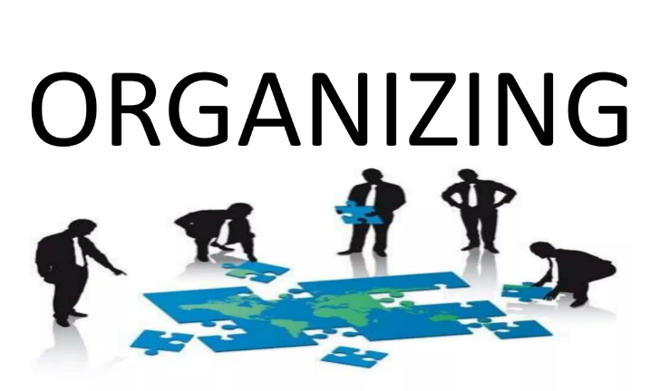
FUNCTIONS of MANAGEMENT

Slide 29
FUNCTIONS of MANAGEMENT
2. ORGANISING
Division of work into functions and sub-functions,
grouping of activities that are closely related in their nature,
assigning of duties and responsibilities to the employees and
finally delegation of authority and power to each employee or the group to discharge their duties accordingly are the processes come under the function of management organizing.

Slide 30
FUNCTIONS of MANAGEMENT
2. ORGANISING
Louis A. Allen –
Definition
"Organization is the process of identifying and grouping of the works to be performed, defining and delegating responsibility and authority and establishing relationships for the purpose of enabling people to work most efficiently".

Slide 31
FUNCTIONS of MANAGEMENT
2. ORGANISING
Importance of Organizing:-
Organizing helps Organizations to reap the benefit of specialization.
Organizing provides for Optimum utilization of resources.
Organizing helps in Effective administration.
Organizing channels for Expansion and growth.
Organizing achieves co-ordination among different departments.
Organizing creates scope for new change.

Slide 32
FUNCTIONS of MANAGEMENT
2. ORGANISING
Organizing Process Division of work:
The first process of Organizing includes identification and division of work which shall be done in accordance with the plans that are determined previously.
Linking departments:
When the process of departmentation was completed, linking of departments has to be done so that those departments operate in a co-ordinated manner which gives a shape to overall organization structure.

Slide 33
FUNCTIONS of MANAGEMENT
2. ORGANISING
Departmentation:
Once the work of identifying and dividing the work has been done those are similar are to be grouped.
Assigning Duties:
On completion of departmentation process assigning duties i.e. defining authority and responsibility to the employees on the basis of their skills and capabilities has to be done, which in consequence magnifies efficiency with regard to their work.
Defining hierarchal structure:
Each employee should also know from whom he has to take orders and to whom he is accountable /responsible.

Slide 34
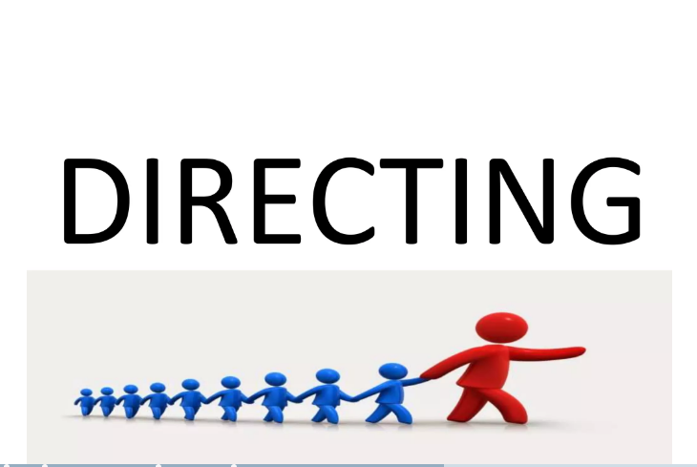
FUNCTIONS of MANAGEMENT

Slide 35
FUNCTIONS of MANAGEMENT
3. DIRECTING
Directing is nothing but guiding and leading the people in an organization.
It is not just giving instructions by a superior to the sub-ordinates but also is a process of supervising, guiding and motivating the latter to achieve the organizational goals.
"Activating deals with the steps a manager takes to get sub- ordinates and others to carry out plans". - Newman and Warren. Definition

Slide 36
FUNCTIONS of MANAGEMENT
3. DIRECTING
Importance of Directing:
Direction initiates actions to get the desired results in an organisation.
Direction attempts to get maximum out of employees by identifying their capabilities.
Direction is essential to keep the elements like Supervision, Motivation, Leadership and Communication effective.
It ensures that every employee work for organisational goals.
Coping up with the changes in the Organisation is possible through effective direction.
Stability and balance can be achieved through directing.

Slide 37
FUNCTIONS of MANAGEMENT

Slide 38
FUNCTIONS of MANAGEMENT
4. STAFFING
In the simplest terms, staffing in management is ‘putting people to jobs’.
"Staffing is the function by which managers build an organisation through the recruitment, selection, and development of individuals as capable employees" - McFarland Definition

Slide 39
FUNCTIONS of MANAGEMENT
4. STAFFING
Importance of Staffing:
Filling the Organisational positions
Developing competencies to challenges
Retaining personnel - professionalism
Optimum utilisation of the human resources

Slide 40
FUNCTIONS of MANAGEMENT
4. STAFFING
Staffing Process
Analyzing Manpower requirements:
It is making an analysis of work and estimating the manpower requirement to accomplish the same.
Recruitment:
It is identifying and attracting capable applicants for employment. it ends with the submission of applications by the aspirants.
Selection:
It is choosing the fit candidates from the applications received in the process of recruitment.

Slide 41
FUNCTIONS of MANAGEMENT
4. STAFFING
Staffing Process
Placement:
This may be on probation and on successfully completion of the same the candidate may be offered permanent employment.
Training and Development:
It is concerned with imparting and developing specific skills for a particular purpose.
Performance Appraisal:
Systematic evaluation of personnel by superiors or others familiar with their performance so as to rank employees to ascertain their eligibility for promotions.

Slide 42
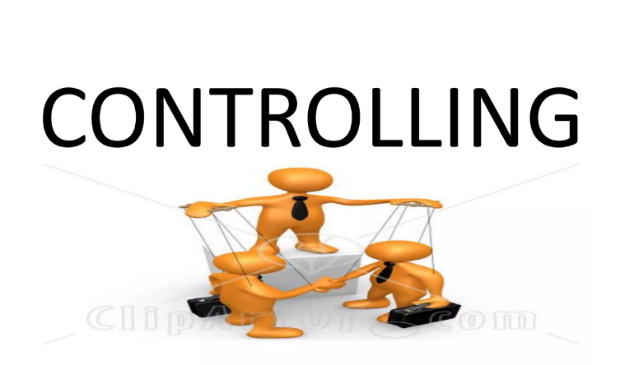
FUNCTIONS of MANAGEMENT

Slide 43
FUNCTIONS of MANAGEMENT
5. CONTROLLING
It is the process that ensures whether the resources are obtained and used efficiently in achieving the organizational objectives
"Controlling is determining what is being accomplished - that is, evaluating performance and, if necessary, applying corrective measures so that performance takes place according to plans".
- Terry and Franklin. Definition

