Slide 1
THEORY – 5
ENVIRONMENTAL STUDIES
3RD SEMESTER, MECHANICAL
Prepared by -
SAROJ KUMAR SAHU,
Lecturer in Mechanical Engineering,
UGMIT, Rayagada

Slide 2
CHAPTER - 2
RENEWABLE AND NON – RENEWABLE RESOURCES
NATURAL RESOURCES
AND
ASSOCIATED PROBLEMS

Slide 3
NATURAL RESOURCES :
The materials we use from nature such as wind energy, water, plants, animals, and fossil fuels to make the things we need are called ‘NATURAL RESOURCES’. They are the basis of life on Earth.
Things/materials of the nature, that can be put to some use by human beings for their growth, development, comfort and other necessities are called as ‘NATURAL RESOURCES’.
Natural Resources fall under 2 main Categories OR All the natural resources can be divided in to two categories:-
Renewable Resources
Non-renewable Resources

Slide 4
a. RENEWABLE RESOURCES
Renewable resources are those that can be replaced or never runs out.
The natural resources which are consumed/ exhausted/ depleted through continuous use and can be recovered by very hard efforts taken up for long periods are called ‘RENEWABLE RESOURCES’.
Examples include solar energy, wind power, geothermal energy, hydroelectric energy (water), soils, forests and biomass (material made from plants and animals).
In other words we can say that all renewable resources are replenished through natural cycle or manually. For example –
Oxygen in air is replenished through photosynthesis.
Fresh water is available through cycles and manually too.
Forest is maintained themselves and manually.

Slide 5
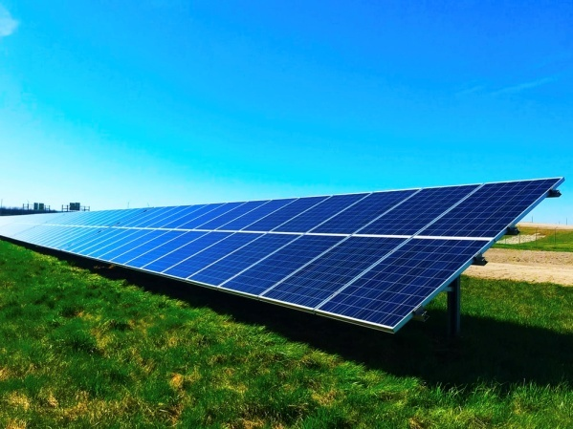
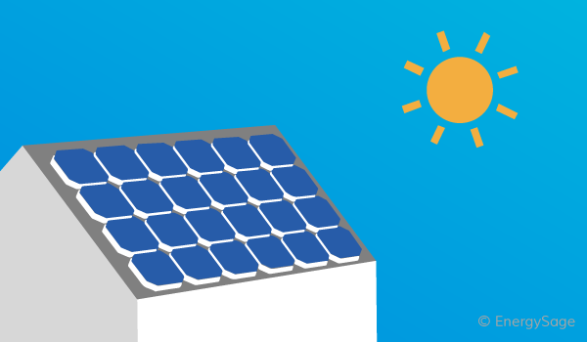
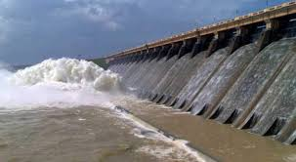
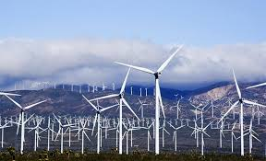
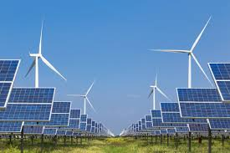
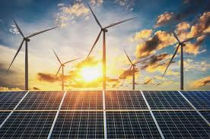

Slide 6
b. NON - RENEWABLE RESOURCES
A nonrenewable resource is a natural resource that cannot be re-made or re-grown at a scale comparable to its consumption.
Nuclear fission uses uranium to create energy.
Nuclear energy is a nonrenewable resource because once the uranium is used, it is gone!
Coal, petroleum, and natural gas are considered nonrenewable because they can not be replenished in a short period of time. These are called fossil fuels.

Slide 7
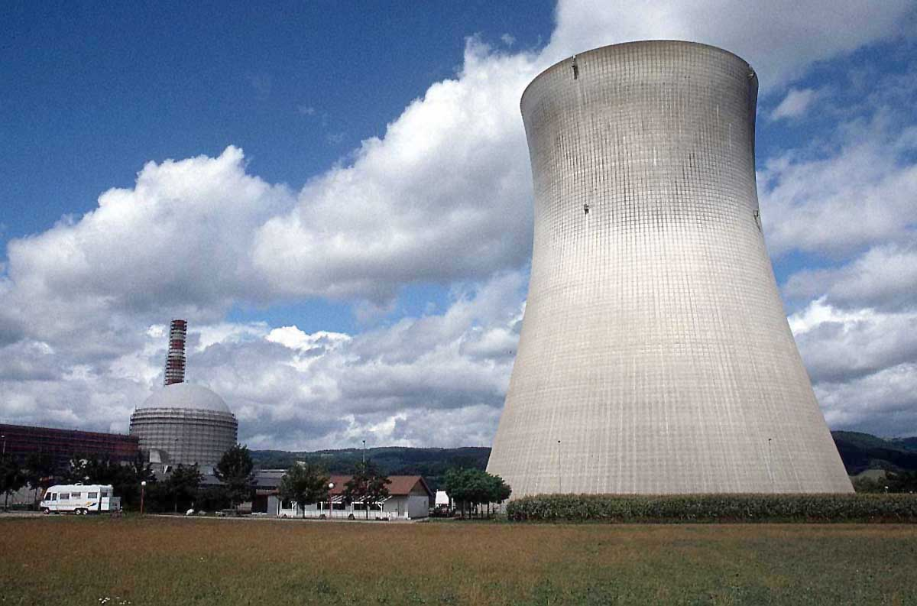
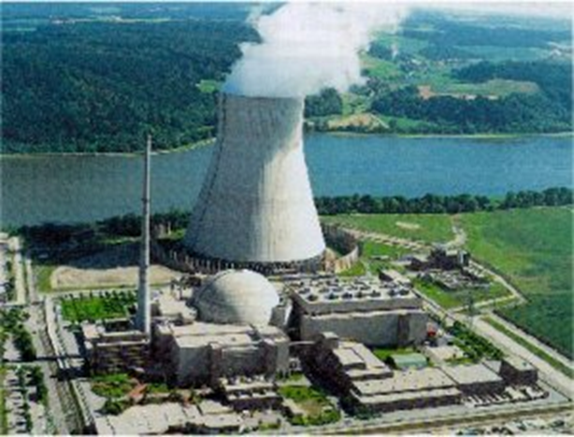
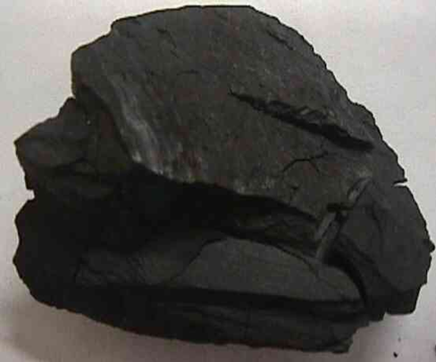
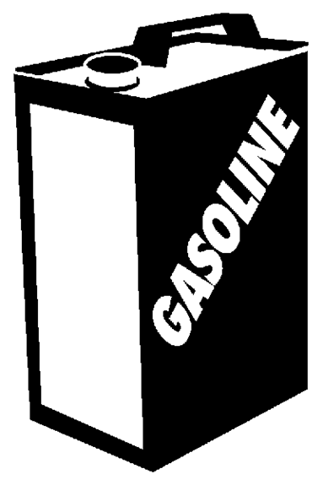
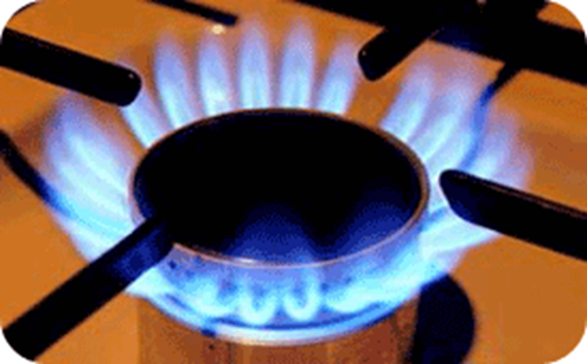

Slide 8

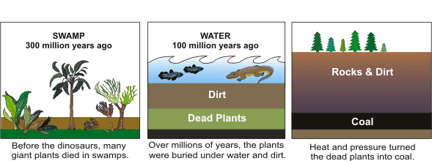

Slide 9

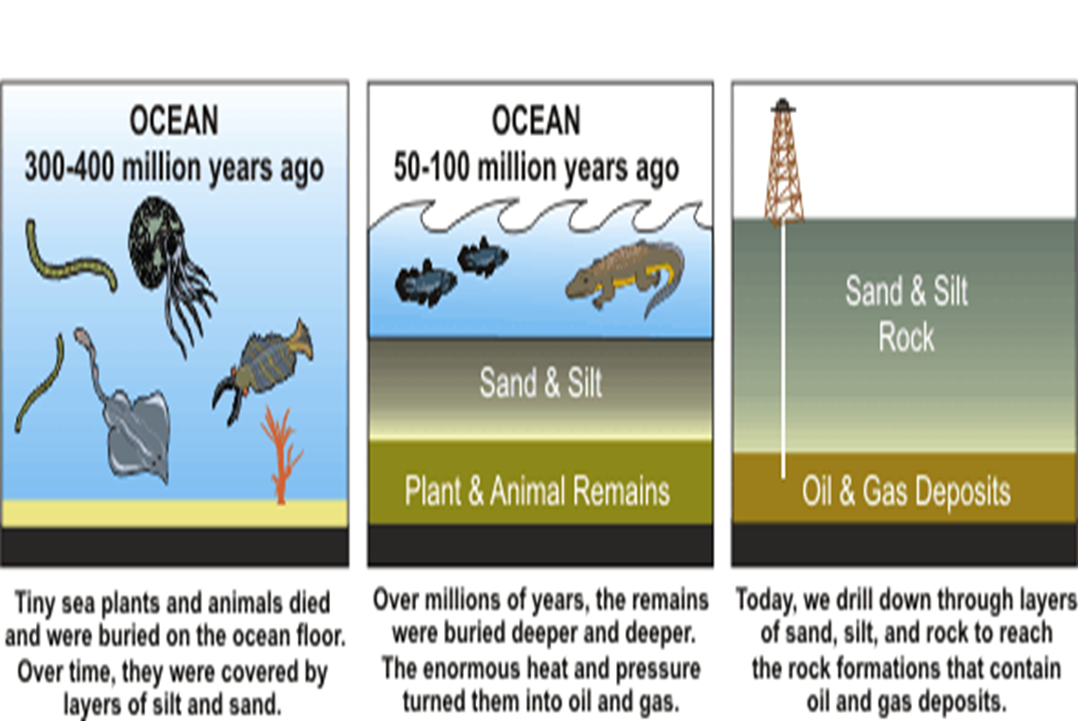

Slide 10
NON RENEWABLE RESOURCES are not replenishable or we can not get back our coal and petroleum reserves in our life time, if once they are consumed/exhausted completely.
NON RENEWABLE RESOURCES are metals (iron, copper, zinc etc.), coal, oil deposits, minerals, stone, salts (phosphate, nitrates, carbonates etc.) etc.
Minerals are often called as ‘STOCK’ resources, because they can be only extracted from earth’s crust once but never be duplicated.
Minerals/ Metals come from a very slow process of geo-thermal concentration, which took millions of years to form. Hence these deposits which occur today can disappear at some point of time in future.
Coal, petroleum and natural gas are called as ‘FOSSIL FUELS’ because they are formed from dead remains of plants and animals buried in the earth long long ago.
They are called fuel because they are burnt to give energy.

Slide 11
RESOURCES :
A RESOURCE can be any thing, which is useful man, or can be transformed into a useful product or can be used to produce a useful thing, e.g. coal, fossil fuels, water, air etc.
TYPES OF RESOURCES
Natural Resources
Human Resources
Man-made Resources
NATURAL RESOURCES
Exists without actions of humankind in the form of matter/ energy which is available in the earth and get used by living thing. Or exist as a separate entity such as fresh water, air and as well as a living organism such as a fish. Or it may exist in an alternate form that must be processed to obtain the resource such as metal ores, petroleum, and most forms of energy.

Slide 12
NATURAL RESOURCES & ASSOCIATED PROBLEMS
As we know man is highly developed/evolved animal as man possess certain special characteristics.
Man apply all their power and intelligence for food and development.
Man develop new technology for utilisation of natural resources.
Now the problem is, how and up to what extent human beings should utilize various resources?????
Resources are valuable gift of nature.
Hence the use of natural resources should depend on knowledge, availability, type, quantity, value, necessity etc.
The use of resources should be in limit not to exhaust them so that ecological balance within the nature should also remain undisturbed.

Slide 13
ASSOCIATED PROBLEMS RENEWABLE RESOURCES
Global livestock (cattle, sheep, pigs, goats, horses, donkeys, mules, buffalo, oxen, llamas, or camels etc.) and fisheries resources can also not be expanded beyond certain limits.
Only up to a limited extent resources of biosphere can be safely exploited.
Though an enormous (very large/huge) quantity of water is present, for fresh water life depends largely on precipitation, which is available only in a finite quantity.
Its uneven distribution over earths surface has caused large area to become infertile deserts.

Slide 14
ASSOCIATED PROBLEMS NON RENEWABLE RESOURCES
Overexploitation shall exhaust many of our valuable deposits which took millions of years to form.
They can not be duplicated within human scale of time.
They require time on geological scale to form.
With the sophisticated technology, we may recover these materials from the highly dispersed state.
But the cause shall be enormous (very large in size, quantity, or extent) & the effort could be economically non-viable.

Slide 15
Based on ownership resources are classified in to
(a) Individual resources (b) Community resources
(c) National resources (d) International resources
a) INDIVIDUAL RESOURCES
Resources that are owned privately by individuals i.e. land owned by farmers
b) COMMUNITY RESOURCES
Resources accessible to all the members of a community i.e. public parks, picnic spots
c) NATIONAL RESOURCES
Resources which belong to a nation or government i.e. mountains, wildlife ,forests
d) INTERNATIONAL RESOURCES
Resources which are under control of international organization i.e. open ocean

Slide 16
LIST OF NATURAL RESOURCES &
ASSOCIATED PROBLEMS:
Forest resources
Water resources
Mineral resources
Food resources
Energy resources
Land resources

Slide 17
INTRODUCTION
The word forest is derived from a Latin word “ Foris” means Outside.
Forest are one of the most important natural resources of the earth.
Approximately 1/3rd of the earth’s total area is covered by forests.
Forest resources play an important role in the economy of any country.
Forest is a community of trees and associated organism covering a considerable area, utilizing air, water and minerals to attain maturity and to reproduce and capable of furnishing mankind with indispensable products and services.

Slide 18
It is highly complex, changing environment made up of a living and non-living things.
Living things include trees, shrubs, wildlife etc. and non-living things include water, nutrients, rocks, sunlight and air.
Forest vary a great deal in composition and density and are distinct from meadows and pastures.
Forest are important to humans and the natural world.
For humans, they have many aesthetics, recreational, economic, historical, cultural and religious values.
Forest provide fuel, wood, timber, wildlife, habitat, industrial, forest products, climate regulations, medicinal etc.

Slide 19
USES OF FOREST
They provide timber for house-building, ship-building, bridges, railway carriages, furniture's etc.
They supply fire wood and charcoal for fuel in homes and in
industries.
They provide wood pulp for the paper and rayon industries.
They provide honey for food and medicines.
They provide bee wax for candles, medicines, shoe-making etc.
They provide canes foe baskets, mats, chairs, ropes, walking sticks and umbrella handles.
They provide sandal wood for carved boxes and small
domestic articles .
They provide tanning (convert animal skin in to leather) materials in the form of wood, barks, leaves, roots, and fruits for tanning hides and skin.

Slide 20
INDIRECT USES OF FOREST
They stop the rain-bearing winds and cause the rainfall.
They increase the moisture content in the atmosphere and
there by provide additional precipitation (i.e. rainfall) in the
Locality.
They minimize the extreme variation in climatic condition
and make the climate more equable.
They control floods during heavy rain by absorbing excess
rain water.
They prevent soil erosion by checking the force of flowing of water.

Slide 21
The thick roots of the trees absorb large quantity of water
thus, forest help in the flow of rivers and streams.
They offer hunting grounds.
They provide shelter to wild animals and birds.
They improve the sanitary condition of a place.
They are a source of revenue to the government.
They facilitate human existence by provide by providing O2
to human beings and absorbing CO2 by human beings.
They provide employment large number of people in
different capacities as wood cutters, carriers etc.

Slide 22
FOREST IN INDIA
In India forest cover estimated 708,273 sq.km to be 21.54% of the country's geographical area. (as per 2017*data)
In India forest cover estimated 712,249 sq.km to be 21.67% of the country's geographical area. (as per 2019*data)
Total country's geographical area 3,287,263 sq.km
India is the 7th largest country in the World.
Forest cover in India is defined as all lands, more than one hectare in area with a tree canopy density of more than 10%.

Slide 23
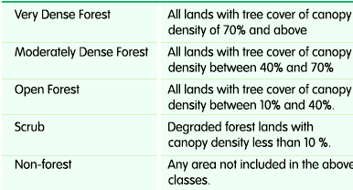
According to the “India State of Forest Report (ISFR)”, in New Delhi. The report is published by the Forest Survey of India (FSI) which has been mandated to assess the forest and tree resources of the country including wall-to-wall forest cover mapping in a biennial cycle, Starting 1987, 16 assessment have been completed so far. ISFR 2019 is the 16th report in the series.

Slide 24
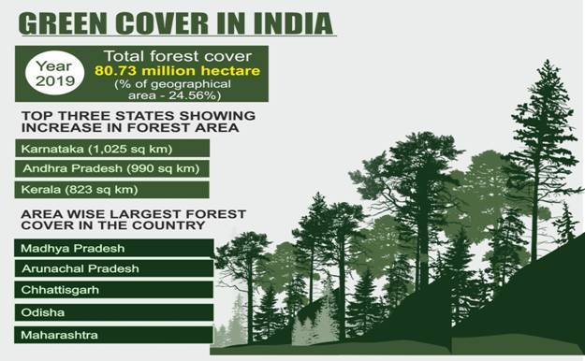
India is among few countries in the world where forest cover is consistently increasing. Union Minister Shri Javadekar told that in the present assessment, the total forest and tree cover of the country is 80.73 million hectare which is 24.56 percent of the geographical area of the country.

Slide 25
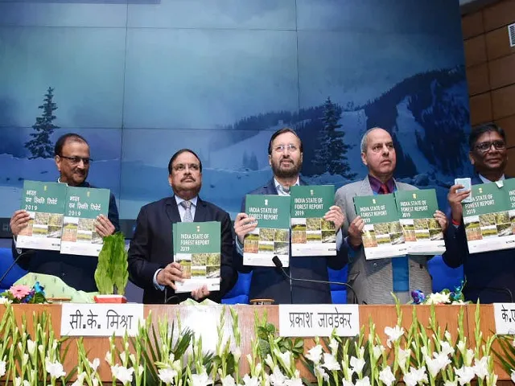
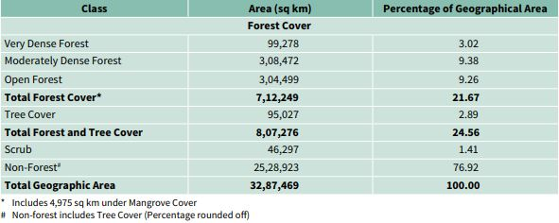

Slide 26
The 2019 survey has found an increase of 5,188 sq km in total forest and tree cover in the country.
Tree and forest cover together made up 24.56% (8,07,276 sq km) of India's area.
In the last assessment it was 24.39%. (Dec 31, 2019)
In a remarkable feat, forest and tree cover has increased by more than 13 Lakhs hectares in the last four years: Union Environment Minister.
The Union Minister for Environment, Forest and Climate Change, Shri Prakash Javadekar today released the biennial “India State of Forest Report (ISFR)”, in New Delhi.(Dec 30, 2019)
The total forest and tree cover of the country is 80.73 million hectare which is 24.56 percent of the geographical area of the country.
Compared to the assessment of 2017, there is an increase of 5,188 sq. (Apr 7, 2020)

Slide 27
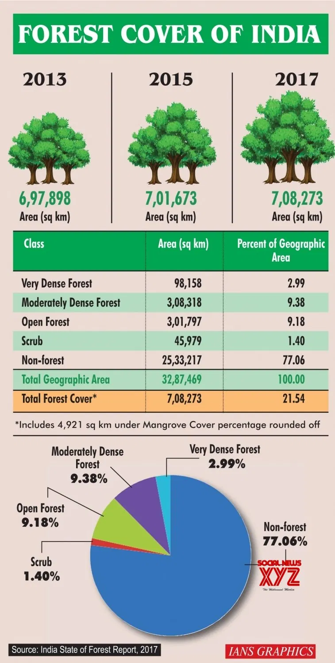

Slide 28
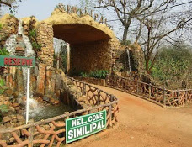
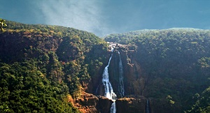
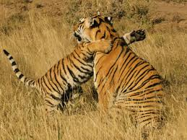
National Goal is to achieve of One-Third percentage of forest/tree cover area under total geographical area by the end of year 2020.
In India the Protected Areas (PA) cover about 14% of the forest area, consisting of
80 National Parks (5 in Odisha)
441 Wild life Sanctuaries (18 in Odisha)
8 Biosphere Reserves (Shimilipal, Baripada, Odisha)

Slide 29
2) DRY TROPICAL FORESTS:
a) Tropical dry deciduous: Madhya Pradesh, Uttar Pradesh
b) Tropical thorn forest: Delhi, Punjab, Gujarat
c) Tropical dry evergreen: Eastern Ghat (Andhra Pradesh, Tamil Nadu)
a b c

Slide 30
3) MONTANA SUB TROPICAL FORESTS :
Coniferous Forests
a) Subtropical broadleaf forest: Shillong, Nilgiris
b) Subtropical pine forest: Arunachal Pradesh, Kashmir
c) Sub Tropical dry evergreen: Foot Hills of Himalayas.
a b c

Slide 31
4) MONTANA TEMPERATE FORESTS :
a) Montana Wet temperate: Nilgiri, Palmi Hills
b) Himalayan wet temperate: Assam, Himachal Pradesh
c) Himalayan dry temperate: Kashmir

Slide 32
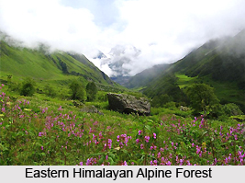
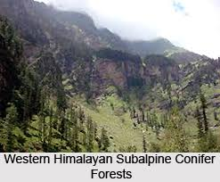
5) SUB ALPINE FORESTS :
a) Moist alpine scrub: high Himalayas
b) Dry alpine scrub: Sikkim

Slide 33
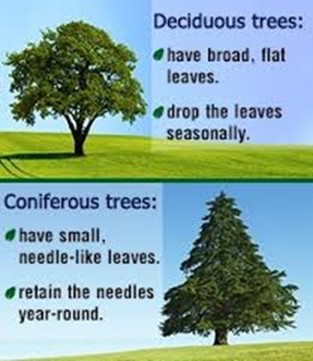
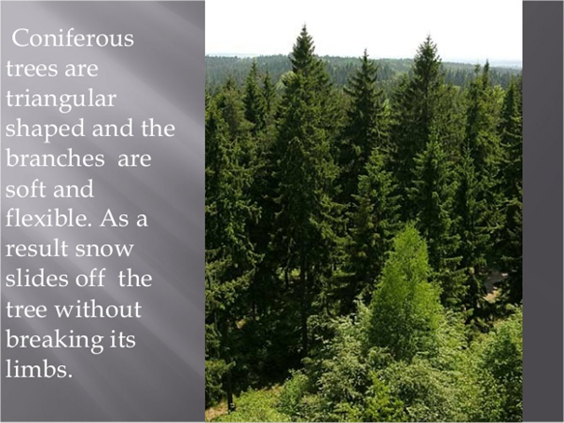
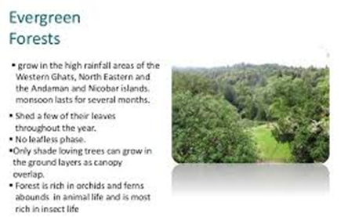
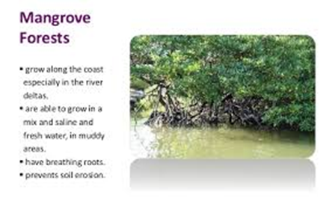

Slide 34
Associated Problems in FOREST RESOURCES
Use and over-exploitation.
Deforestation (& Case Studies )
Timber extraction.
Mining and its effects on forest.
Dams and their effects on forests and tribal people.

Slide 35
USES OF FOREST
(Broad classification)
The functions of forest may broadly classified in to following categories :
LOCAL CONSUMPTIVE USE
PRODUCTIVE OR MARKET USE
ECOSYSTEM SERVICES
OTHER USES

Slide 36
1. LOCAL CONSUMPTIVE USE
Food like roots, fruits, tubers,
fish, mushrooms, animal meat e.t.c.
Fodder for cattle.
Fuel Wood: The wood is used as
fuel for cooking and other purposes
by poor people.
Construction material like poles,
thatching leaves.
Fiber for weaving baskets, ropes,
nets, mats.
Medicinal plants for treating
common diseases.

Slide 37
2. PRODUCTIVE OR MARKET USE
Timber: Wood used for commercial purposes like for making furniture and other items like boats, bridges and other day to day uses.
Fruits, fiber, honey, gum e.t.c.
Cane and bamboo products.
Raw material for wood based industries:
forest provide raw material for various wood based industries like paper and pulp, sports goods, furniture, match boxes etc.

Slide 38
3. ECOSYSTEM SERVICES
Atmospheric and climate regulation
Erosion control
Watershed protection
Floods and drought control

Slide 39
3. ECOSYSTEM SERVICES
Forest Provide protection against
Soil erosion
Floods
Droughts
Noise
Radiations
Soil erosion Soil erosion Floods Droughts

Slide 40

REDUCTION OF GLOBAL WARMING
The main green house gas CO2 is used by forests for photosynthesis process the forest act as a sink for CO2 there by reducing the green house effect due to CO2
ABSORPTION OF AIR POLLUTANTS
Forest absorbs many toxic gasses and air pollutants and can help in keeping air pure.

Slide 41
CONSERVATION OF SOIL
They prevent soil erosion by binding the soil particles tightly in their roots.
They also reduce the velocity of wind and rain which are chief agents causing erosion.
IMPROVEMENT IN FERTILITY OF SOIL
The fertility of soil increases due to humus ( the organic component of soil, formed by the decomposition leaves and other plant materials by the soil microorganism) formed by the decay (decompose through the action of bacteria and fungi) of forest litter ( the layer of dead plant material present on the soil surface).

Slide 42
CONTROL OF WATER FLOW
The forest act as a giant sponge they slow down run off, absorbing and holding water that recharges springs, streams, and ground water.
HABITAT TO WILDLIFE
They provide the habitat for high wild life species

Slide 43
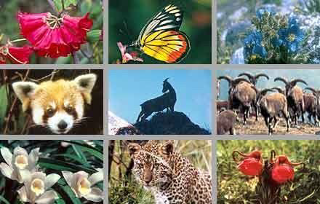
ACCESSORY FUNCTION
Forest provides education, recreation, research, aesthetics (beauty), habitat to various flora and fauna, social, religious and spiritual needs.

Slide 44
REASON FOR DEFICIENCY OF FOREST:
In India the minimum area of forest required to maintain good ecological balance is about 33% of total geographical area.
But at present it is only about 12%. So over exploitation of forest material occurs.
OVER EXPLOITATION OF FOREST:
Due to over population, there is an increased demand for medicine, shelter, wood and fuel.
Hence exploitation of forest materials is going on increasing.
Cause of over exploitation:
1. Increasing agricultural production.
2. Increasing agricultural activities.
3. Increase in demand of wood resources.

Slide 45
FOREST DEGRADATION IN INDIA
At the beginning of 20th century about 30% of land in India was covered with forests but by the end of 20th century the forest cover was reduced to 20%.
As a result of exploitation, the tropical forest cover in India, is now only reduced to coastal Western Ghats and Northern India.
We have a huge population size and a very low precipitate forest area 0.075 Ha per capita as compared to 0.64 ha/capita of world forest area.
The National forest policy has recommended 33 % forest area for plains and 67 % for hills.
The deforestation rate per unit population in India is lowest among the major tropical countries.
For effective forest management of country we have to take the confidence of tribal who have been living in forest.

Slide 46
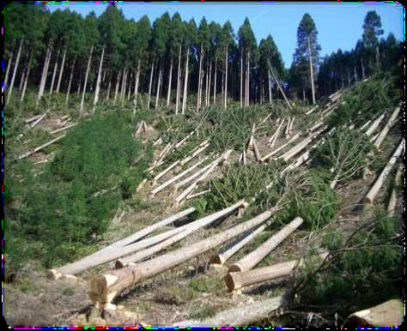
DELETION OF FOREST RESOURCES
The history of the exploitation of forest is as old as man himself but during older times, the exploitation was balanced through natural growth of forest because at that time , exploitation was only for personal and community uses.
But in recent year , depletion of forest has been on a large scale.
DEFORESTATION :
The conversion of forest areas in to
Non-forest areas is known as Deforestation.
Deforestation is the removal of trees
without sufficient reforestation.

Slide 47
DEFORESTATION
Deforestation is the permanent removal of trees to make room for something besides forest. This can include clearing the land for agriculture or grazing or using the timber for fuel, construction or manufacturing.
Deforestation is the loss or continual degradation of forest habitat due to either natural or human related causes.
Human caused deforestation can be agriculture, urban sprawl, unsustainable forestry practices, mining and petroleum exploration.
Natural caused deforestation can be linked to Tsunamis, forest fire, volcanic eruption, glaciation and desertification.

Slide 48
Deforestation defined broadly can include not only conversion to non-forest, but also degradation that reduces forest quality like the density and structure of the trees, the ecological services supplied, the biomass of plants and animals, the species diversity and the genetic diversity.
Narrow definition of deforestation is the removal of forest cover to an extent that allows for alternative land use.
The term DEFORESTATION has been used to refer to fuel wood cutting, commercial logging and the slash and burn technique, a component of some shifting cultivation agricultural systems.
It is also used to describe forest clearing for annual crops, for grazing, and establishment of industrial forest plantation.
Related terms of deforestation are forest decline, forest fragmentation, forest degradation, forest depletion, loss of forest cover.

Slide 49
CAUSES OF DEFORESTATION
Expansion of agriculture, more forest have been cleared for agriculture.
Large area of forest lands have been cleared for urbanization and human settlement.
Commercial exploitation of forest .
Forest fires .
Mining activities in forest areas.
Forest diseases are also partly responsible for depletion
forest.

Slide 50
Consequences of Deforestation (or) Impacts of Deforestation:
1. Economic loss
2. Loss of biodiversity
3. Destructs the habitats of various species
4. Reduction in stream flow
5. Increases the rate of global warming
6. Disruption of weather patterns and global climate
7. Degradation of soil and acceleration of the rate of soil erosion.
8. Induces and accelerates mass movement / land slides.
9. Increases flood frequency, magnitude / severity.
10.Breaks the water cycle
11.Breaks the nutrient cycle

Slide 51
PREVENTIVE MEASURES (OR)
AVOID OF DEFORESTATION (OR)
CONSERVATION OF FOREST
Regulated and planned cutting of trees.
Control over forest fires.
Reforestation.
Afforestation .
Check on forest clearance for agriculture and human habitation and settlement.

Slide 52
Development green belt around cities.
Education and awareness programs must be conducted.
Check on mining activities in forest areas.
Protection of existing forest.
Conservation of threatened species of trees.
Social forestry and agro-forestry.
Development of national parks and sanctuaries.
Development of botanical gardens.
Forest pests can be controlled by spraying pesticides by using aero planes.
Development of seed banks.
Forest management.
Proper role of government in forest conservation.
Strict implementation of law of Forest conservation Act.

Slide 53
Case study:
Deforestation in the Himalayan region, involves clearing of natural forests and plantation of monoculture like Eucalyptus.
Nutrient in the soil is poor,
therefore soil losing their fertility.
Hence, Himalayan area facing the serious problem of desertification (the process by which fertile land becomes desert).

Slide 54
CASE STUDIES
JHUM CULTIVATION
> Jhum Agriculture or Shifting Agriculture has destroyed large number of hectare of forest tracts in North-Eastern states and Orissa.
> Jhum agriculture is subsidence agriculture in which tract (large area) of forest land is cleared by cutting trees and it is used for cultivation.
> After few years, when productivity of the land decreases, cultivators abandon the land and clear next tract.
> As a result of this practice, combined with increasing population there is rapid deforestation as more and more cultivators clear forest to cultivate land.
> Also, with increase in population there is cultivators are forced to return to previous tracts of land in relatively shorter durations, not allowing the land to regain its productivity.

Slide 55
2. CHIPKO MOVEMENT
> The Chipko movement or Chipko Andolan is a social-ecological movement that practiced the Gandhian methods of satyagraha and non-violent resistance, through the act of hugging trees to protect them from being felled.
> The modern Chipko movement started in the early 1970s in the Garhwal Himalayas of Uttarakhand, with growing awareness towards rapid deforestation.
The world famous Chipko Movement, pioneered by Dasohli Gram Swarajya Mandal in Gopeshwar brought about a general awareness about conservation of forests.
The first Chipko Movement dates back to 1731, when a village woman named Amrita Bai led the Bishnoi women against the Maharajas men to prevent them from cutting trees.
In this attempt to save the trees, she sacrificed her life along with the lives of her husband, three daughters and 363 people.
The movement was given this name because the village women embraced or hugged the trees to stop them from being cut.
In 1972, in Uttar Pradesh, the Chipko Movement was led by Bachnoi Devi of Advani who protected the hill forests from the contractors axe men.

Slide 56
The landmark event in this struggle took place on March 26, 1974, when a group of peasant (poor agricultural labourer) women in Reni village, Hemwalghati, in Chamoli district, Uttarakhand, India, acted to prevent the cutting of trees and reclaim their traditional forest rights that were threatened by the contractor system of the state Forest Department.
Their actions inspired hundreds of such actions at the grassroots level throughout the region.
By the 1980s the movement had spread throughout India and led to formulation of people-sensitive forest policies, which put a stop to the open felling of trees in regions as far reaching as Vindhyas (eastern side of the Gujarat peninsula) and the Western Ghats (is a mountain range that traverses south through the states of Maharashtra, Goa, Karnataka and Kerala).
In 1980, Sundarlal Bahuguna , a Gandhian activist and philospher, joined the campaign opposing construction of a proposed Himalyan dam on the river near his birth place of Tehri.

Slide 57
Bahuguna ended a 45 days fast in 1995 on the protest of Tehri Dam Project (on the Bhagirathi River near Tehri in Uttarakhand, India of 1000 MW capacity)
Bahuguna again committed another fast (ended after 74 days) after the undertaking of Prime Minister regarding review of project.
“We the Himalaya are facing crisis of survival due to the suicidal activities being carried out in the name of development. The monstrous Tehri Dam is a symbol of this. There is need for a new and long term policy to protect the dying Himalaya. I do not want to see the death of the most sacred (connected to God) river of the world – The Ganga- for short term economic gains”.
(Sunderlal Bahuguna).

Slide 58
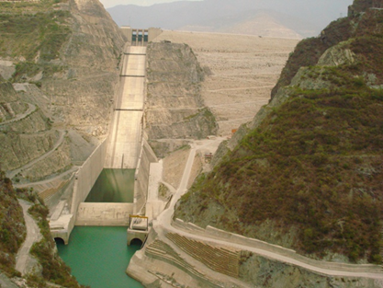
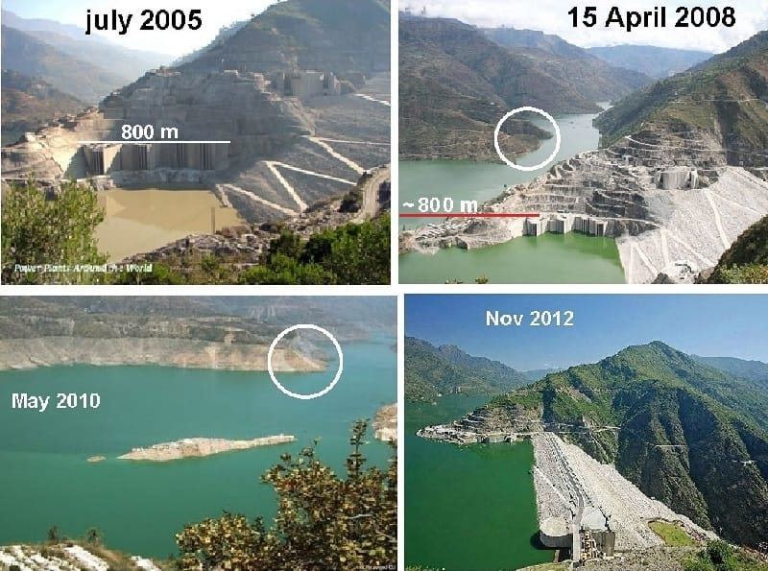
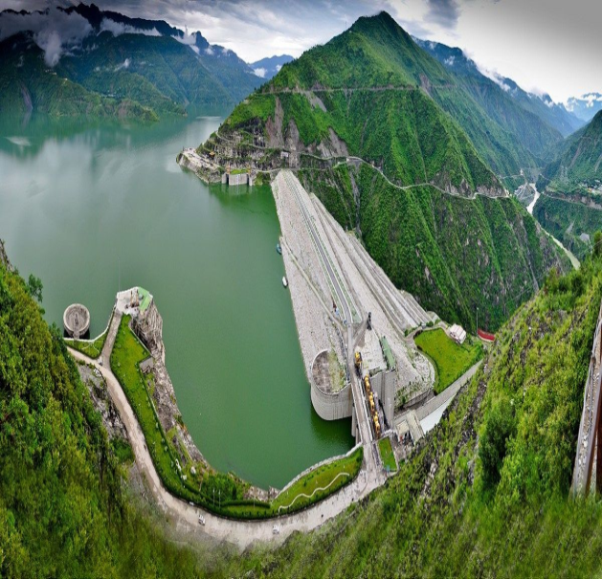
TEHRI DAM VIEWS

Slide 59
3. WESTERN HIMALAYAN REGION
Over the last decade, there has been widespread destruction and degradation of forest resources in Himalayas, especially Western Himalayas.
This has resulted in various problems such as erosion of top soil, irregular rainfall, changing weather patterns and floods.
Construction of roads on hilly slopes, have not only undermined their stability, but also damaged protective vegetation and forest cover.
Tribes in these areas are increasingly facing shortage of firewood and timber, due large scale tree cutting.
> Increased traffic volumes on these roads leads to increased pollution in the area.

Slide 60
EFFECTS OF TIMBER EXTRACTION
> The major effects of timber extraction on forest and tribal people include:
Poor logging results in a degraded forest.
Floods may be intensified by cutting of trees or upstream watersheds.
Loss of biodiversity.
Climatic changes such as less rains.
New logging roads permit shifting cultivators to gain access to logged areas and cut the remaining trees.
It results in forest fragmentation which promotes loss of biodiversity because some species of plants and animals require large continuous areas of similar habitat to survive.
Exploitation of tribal people by the contractors.
Soil erosion especially on slopes occurs extensively.
Sedimentation of irrigation systems, floods may be intensified by cutting of trees on upstream.

Slide 61
MINING
The process of extracting mineral resources and fossil fuels like coal from the earth is called as mining.
Types of mining
Surface mining: Mining of minerals from shallow deposits
Underground mining: Mining of minerals from deep deposits
Steps involved in mining
Exploration
Development
Exploitation
4. Ore processing
Extraction and purification of minerals
The extent of damage by underground mining is more than that of surface mining, which needs enormous amount of land area for its operation and management.

Slide 62
EFFECTS OF MINING
Pollute soil, water and air.
2. Destruction of natural habitat.
Continuous removal of minerals leads to the formation of trench where water is logged which contaminates the ground water.
4. Vibrations cause earth quakes.
5. Produces noise pollution.
6. Reduces shape and size of the forest.
7. Increased risk of landslides.
8. Spoils the aesthetic beauty.

Slide 63
DAMS
Today there are more than 45,000 large dams around the world, which play an important role in communities and economies that harness (control and make use of) these water resources for their economic development.
Current estimates suggest some 30-40% of irrigated land worldwide relies on dams.
Hydropower, another important the use of stored water, currently supplies 19% of the world’s total electric power supply and is used in over 150 countries.
The world’s two most populous countries – China and India – have built around 57% of the world’s large dams.

Slide 64
DAMS PROBLEMS
Dams are the massive artificial structures built across the rivers to store water for much beneficial purpose.
Dams are considered a “Temples of modern India”.
Dams destruct vast area of forest area.
India has more than 1600 large dams.
EFFECTS OF DAMS ON FOREST
Thousands of hectares of forest will be cleared.
Killing of wild animals and destruction of aquatic life.
Spreading of water borne diseases.
Water logging increases the salinity of the soil.
Ex: Narmadha Sagar project it has submerged 3.5 lakhs hectares of forest.

Slide 65
EFFECTS OF DAM ON TRIBAL PEOPLE
Construction of big dams lead to the displacement of tribal people.
2. Displacement and cultural change affects the tribal people both mentally and physically.
3. They do not accommodate the modern food habits and life style.
4. Tribal people are ill treated (act cruelly towards (a person or animal)) by the modern society.
5. Many of the displaced people were not recognized and resettled or compensated.
6. Body condition of tribal people will not suit with new areas and hence they will be affected by many diseases.

Slide 66
CASE STUDY- SARDAR SAROVAR PROJECT
The World Bank’s withdrawal from the Sardar Sarovar Project in India in 1993 was a result of the demands of local people threatened with the loss of their livelihoods and homes in the submergence area.
This dam in Gujarat on the Narmada has displaced thousands of tribal folk, whose lives and livelihoods were linked to the river, the forests and their agricultural lands.
While they and the fishermen at the estuary (the tidal mouth of a large river, where the tide meets the stream), have lost their homeland, rich farmers downstream will get water for agriculture.
The question is why should the local tribals be made homeless, displaced and relocated to benefit other people?
Why should the less fortunate be made to bear the costs of development for better off farmers?
It is a question of social and economic equity as well as the enormous environmental losses, including loss of the biological diversity of the inundated forests in the Narmada valley.

Slide 67
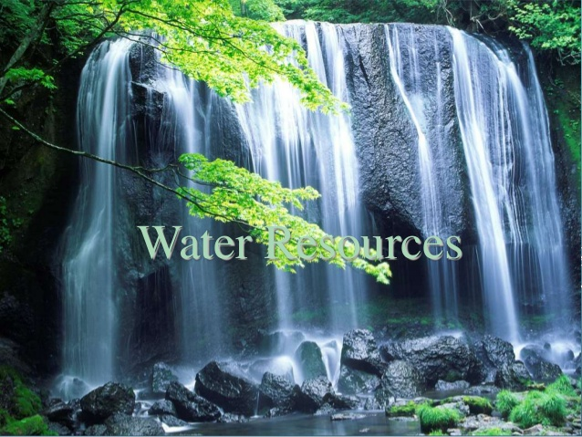

Slide 68
2. WATER RESOURCES
Water is a crucial natural resources without which life in this earth can not be possible.
Water resources are sources of water that are potentially useful for Agricultural, Industrial, Household, Recreational and environmental activities.
Sources of water that are useful to humans.
Virtually all of these human uses require fresh water.
Fresh water is renewable resources like soil and air.

Slide 69
The worlds is supplied by clean and fresh water and it is decreasing.
Water is one of our most critical resources, but around the World it is under threat.
Water demand already exceeds supply in many parts of the world and as the world population continues to rise, so too does the water demand.
On the earth is a 97% of salt water and the 3% is fresh water.
World Ocean water covers about 75 percent of the surface of the earth.
Therefore, the earth is called the Water planet.
Ocean water is saline and not fit for human consumption.
Salt water is like a large amount of salt in the ocean.
Fresh water is just about 2.7 percent of the total water.
Fresh water is a renewable resource & in World it is decreasing.
Hence we must take step to conserve water.

Slide 70
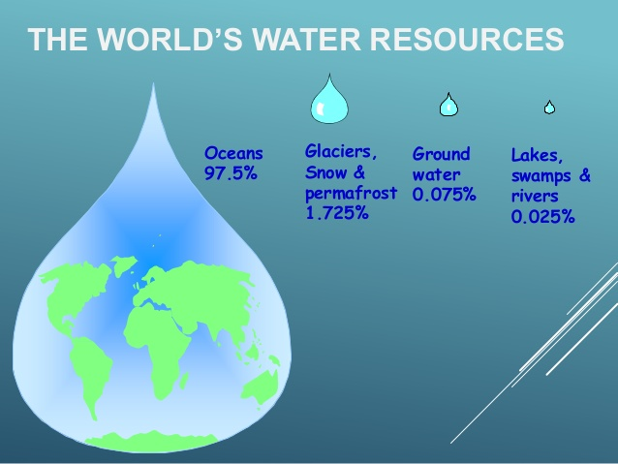

Slide 71
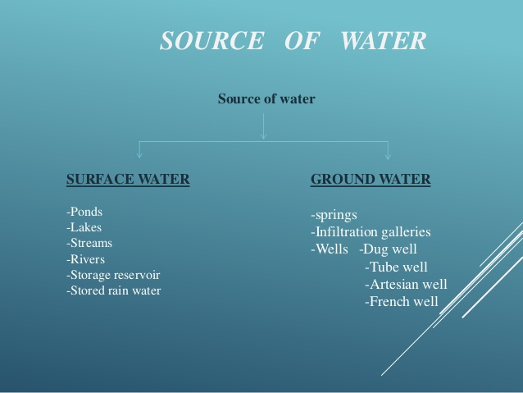
SOURCE OF WATER
SURFACE WATER -Ponds -Lakes -Streams -Rivers -Storage reservoir -Stored rain water
GROUND WATER -springs -Infiltration galleries -Wells -Dug well -Tube well -Artesian well -French well

Slide 72
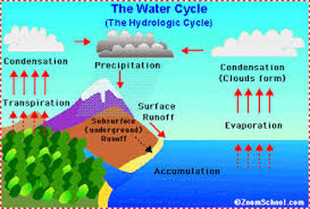
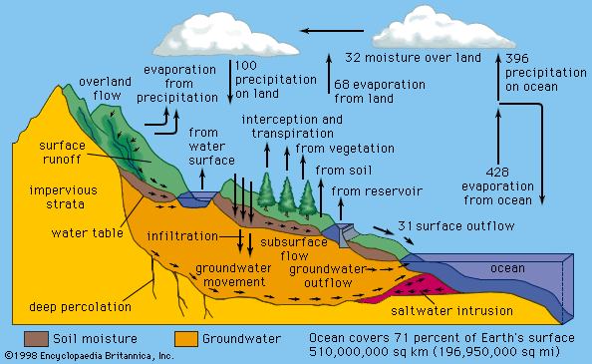
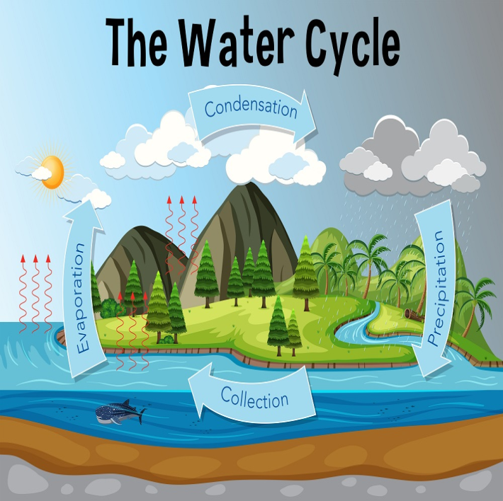
HYDROLOGICAL CYCLE
Water from various water bodies
Evaporated by solar energy
Enters in to the atmosphere as clouds
Falls again on earth as rain or snow
Ultimately returns to the ocean.

Slide 73
USE OF WATER RESOURCES
Water is essential for all forms of life.
Many uses of water include agricultural, industrial, household, recreational and environmental activities.
Virtually, all of these human uses, require fresh water.
No plant or animal species can survive without water.
If water in our body drops by 1% we feel thirst,
if it drops by 10% we face death.

Slide 74
AGRICULTURAL USE
Agriculture accounts for 69 percent of all water consumption basically in agricultural economies like India.
Agriculture, therefore, is the largest consumer of the Earth’s available freshwater.
By 2050, the global water demand of agriculture is estimated to increase by a further 19% due to irrigational needs.
Expanding irrigation needs are likely to put undue pressure on water storage.
It is still inconclusive whether further expansion of irrigation, as well as additional water withdrawals from rivers and groundwater, will be possible in future.

Slide 75
INDUSTRIAL USE
Water is the lifeblood of the industry.
It is used as a raw material coolant, a solvent, a transport agent, and as a source of energy.
Manufacturing industries account for a considerable share in the total industrial water consumption.
Besides, paper and allied products, chemicals and primary metals are major industrial users of water.
Worldwide, the industry accounts for 19 percent of total consumption.
In industrialized countries, however, industries use more than half of the water available for human use.

Slide 76
DOMESTIC USE
It includes drinking, cleaning, personal hygiene, garden care, cooking, washing of clothes, dishes, vehicles, etc.
Since the end of World War II there has been a trend of people moving out of the countryside to the ever-expanding cities.
This trend has important implications on our water resources.
Government and communities have had to start building large water-supply systems to deliver water to new populations and industries.
Of all water consumption in the World, domestic use accounts for about 12 percent.

Slide 77
HYDROPOWER GENERATION
Electricity produced from water is hydropower.
Hydropower is the leading renewable source of electricity in the world.
It accounts for about 16 percent of total electricity generation globally.
There are many opportunities for hydropower development throughout the world.
Today, the leading hydropower generating countries are China, the US, Brazil, Canada, India, and Russia.

Slide 78
NAVIGATION AND RECREATION
Navigable waterways are defined as watercourses that have been or may be used for transport of interstate or foreign commerce.
Agricultural and commercial goods are moved on water on a large scale in a number of regions in the world.
Water is also used for recreational purposes such as boating, swimming, and sporting activities.
These uses affect the quality of water and pollute it.
Highest priority should be given to public health and drinking water quality while permitting such activities in reservoirs, lakes, and rivers.

Slide 79
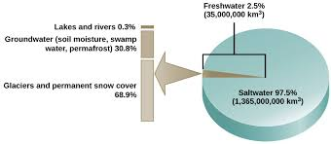
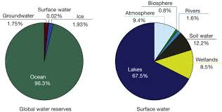

Slide 80
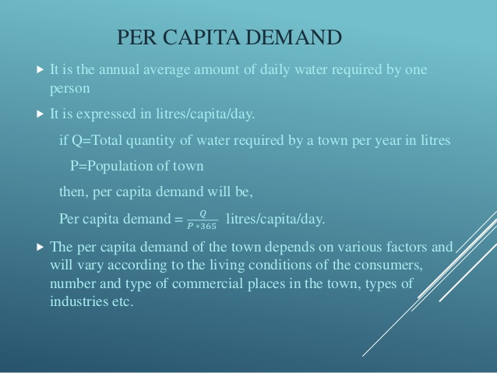

Slide 81
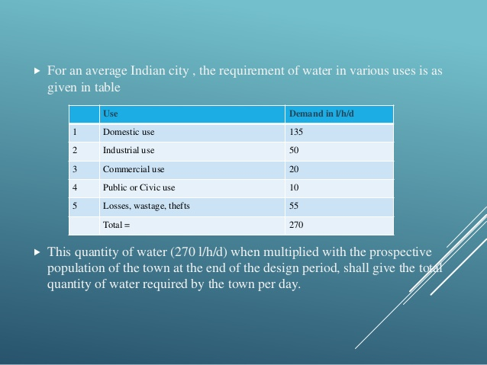

Slide 82
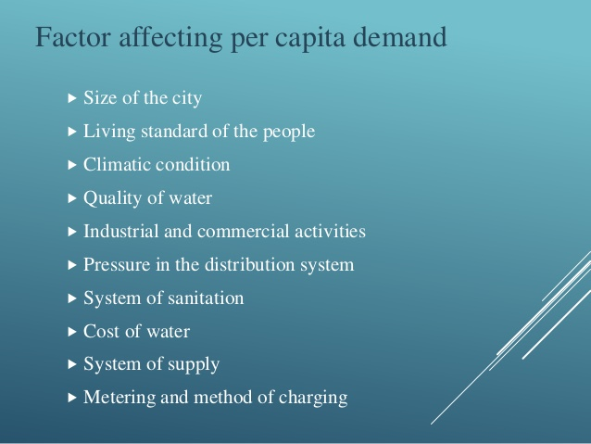

Slide 83
ASSOCIATED PROBLEMS OF WATER RESOURCES
Overutilization
Pollution of Surface Water
Pollution of Ground Water
Global Climate Change
Floods
Droughts

Slide 84
OVERUTILIZATION OF SURFACE AND GROUND WATER
Water scarcity has become a burning global issue.
The UN has held several conventions on water in recent decades.
Continuous overutilization of surface and ground water has led to virtual water scarcity in the world today.
The depleting sources for high growth in human population over the centuries and increased man-induced water pollution across the world have created unforeseen water scarcity around the globe.
As a result, there has been continuous overutilization of the existing water sources due to mammoth growth in world population.
Groundwater is the major source of water in many parts of the world.
However, there has been continuous depletion of this source due to its overexploitation by rising human population and the rapid rise in industrialization and urbanization in modern times.

Slide 85
CONSEQUENCES OF OVERUTILIZATION
Water scarcity now becomes an important topic in international diplomacy.
Nearly three billion people in the world suffer from water scarcity.
The ongoing Jordan River conflict, Nile River conflict, and Aral Sea conflict are cases in point.
The intra-state issues such as Kaveri Water dispute in South India, 2000 Health Organization (WHO) sources, a combination of rising global population, economic growth and climate change means that by 2050 five billion (52%) of the world’s projected 9.7 billion people will live in areas where fresh water supply is under pressure.
Researchers expect about 1 billion more people to be living in areas where water demand exceeds surface-water supply.

Slide 86
GLOBAL CLIMATE CHANGE
Scientists, environmentalists, and biologists worldwide are now alarmed that climate change can have an impact on the drainage pattern and hydrological cycle on the earth thereby severely affecting the surface and groundwater availability.
Climate change is believed to rise the global temperature at an increasing pace.
Temperature increase affects the hydrological cycle by directly increasing evaporation of available surface water and vegetation transpiration.
As a result, precipitation amount, timing and intensity rates are largely affected.
It impacts the flux and storage of water in surface and subsurface reservoirs.

Slide 87
FLOODS
Floods is a natural hazards due to excess in water flow.
The amount of rainfall received by an area varies from one place to another depending on the location of the place.
In some places it rains almost throughout the year whereas in other places it might rain for only few days.
India records most of its rainfall in the monsoon season.
Heavy rains lead to rise in the water level of rivers, seas, and oceans.
Water gets accumulated in the coastal areas, which results in floods.
Floods bring in extensive damage to crops, domestic animals, property and human life.
During floods, many animals get carried away by the force of water and eventually die.

Slide 88
DROUGHTS
Drought is a natural hazards due to scarcity of water.
Droughts set in when a particular region goes without rain for a long period of time.
In the meantime, the soil will continuously lose groundwater by the process of evaporation and transpiration.
Since this water is not brought back to earth in the form of rains, the soil becomes very dry.
The level of water in the ponds and rivers goes down and in some cases water bodies get dried up completely.
Ground water becomes scarce and this leads to droughts. In drought conditions, it is very difficult to get food and fodder for the survival.
Life gets difficult and many animals perish in such conditions.
Frequent floods and droughts are mostly due to climate change and global warming.
Various environmental organizations world over of the view that climate change is a long-term change in weather patterns, either in average weather conditions or in the distribution of extreme weather events.

Slide 89
MAJOR WATER CONFLICTS
Conflict through use:
Some of the major water conflicts (interstate and international disputes) that have become thorn in relations between states and countries due to unequal distribution of water are:-
International conflicts:
Water conflict in the middle east
Countries involved are Sudan, Egypt and Turkey. It also affects countries which are water starved viz. Saudi Arabia, Kuwait, Syria, Israel and Jordan.
2) The Indus water treaty - dispute between India and Pakistan
3) The Colorado river water dispute - between Mexico and USA

Slide 90
National conflicts:
1) The Cauvery water dispute – between Tamil Nadu and Karnataka.
2) The Krishna water dispute – between Karnatak and Andhrapradesh
3) Siruvani water dispute – between Tamil Nadu and Kerala
4) The Satluj-Yamuna link canal dispute
The dispute is between two Northern states viz. Punjab and Haryana and UP, Rajasthan and Delhi has also interest in it .
In traditional water management, innovative arrangements ensure equitable distribution of water, which are democratically implemented.
These disputes can be solved amicably through ‘Gram Panchayats”, if transparency is maintained.
But disputes between countries or states sometimes attain war like situation and are difficult to solve.

Slide 91
DAMS - BENEFITS AND PROBLEMS
Water is a precious resource and its scarcity is increasing at global level. There is a pressure to utilise surface water resources efficiently for different purposes. According to World Commission on Dam Report -2001 there are 45000 large dams spread over 140 countries.
Major benefits of dams:
1. Hydroelectricity generation.
2. Year round water supply to ensure higher productivity.
3. Equal water distribution by transferring water from area of excess to area of deficit.
4. Helps flood control and protects soil.
5. Assure irrigation during dry periods.
6. River valley projects provide inland water navigation ,employment opportunities and can be used to develop fish hatcheries and nurseries.
7. River valley projects have tremendous potential for economic upliftment and will help to raise the standard of living and can help to improve the quality of life.

Slide 92
Disadvantages/problems of dams:
> Although dams have proved very useful over the centuries but recent past big dams has created lot of human as well as environmental issues.
1. Submergence of large areas may lead to loss of fertile soil and displacement of tribal people.
2. Salt left behind due to evaporation increase the salinity of river water and makes it unusable when reaches down stream.
3. Siltation and sedimentation of reservoirs not only makes dams use less but also is responsible for loss of valuable nutrients.
4. Loss of non-forest land leads to loss of flora and fauna.
5. Changes in fisheries and the spawning grounds.
6. Stagnation and water logging near reservoir leads to breeding of vectors and spread of vector-borne diseases.
7. Growth of aquatic weeds may lead to microclimatic changes.

Slide 93
CONSERVATION OF WATER
Avoid leakage of water from the taps.
Turn the tap off when not in use especially when you brush your teeth or wash clothes.
Rainwater harvesting is the another method to conserve water.
The water supply should be limited in those areas which enjoys the unlimited water supplies.
Technical methods to conserve water :
1. Rainwater Harvesting
2. Historical Water Bodies
3. Ponds

Slide 94
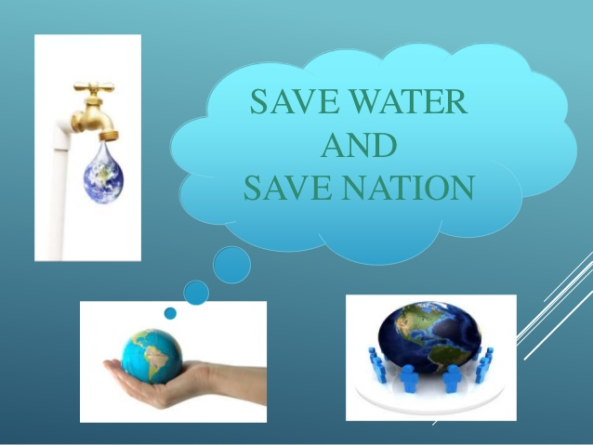
SAVE WATER AND SAVE NATION

Slide 95
3. MINERAL RESOURCES
Mineral Resource is defined as a occurrence of natural, solid, inorganic or fossilized organic material in or on the Earth’s crust in such form and quantity and of such a grade or quality that it has reasonable prospects for economic extraction.
Minerals are naturally occurring, inorganic, crystalline solids having a definite chemical composition and characteristic physical properties.
Naturally occurring inorganic crystalline solids with uniform chemical composition are called as minerals.

Slide 96
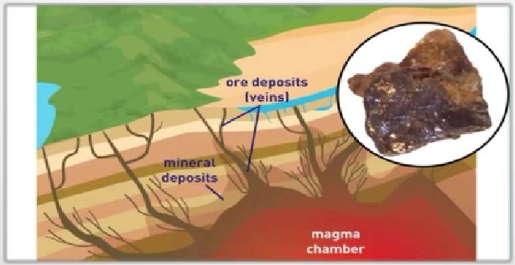
Minerals are formed over a period of millions of years in the earth’s crust.

Slide 97
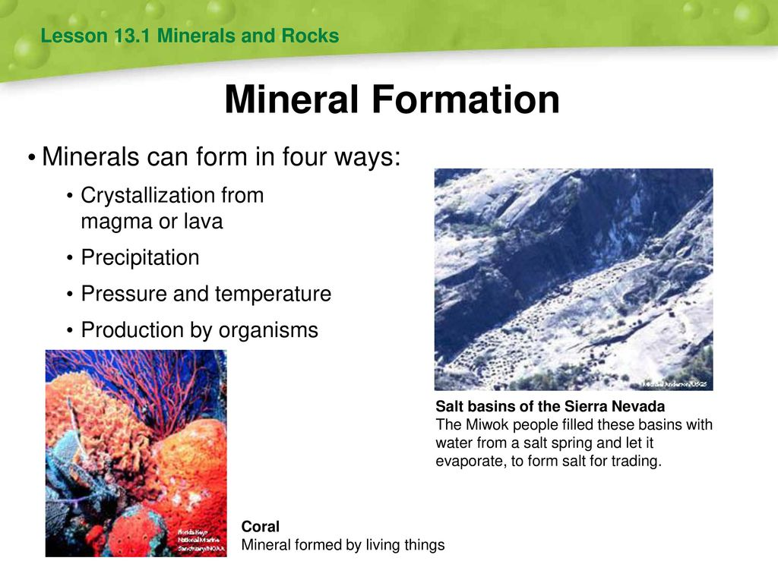

Slide 98
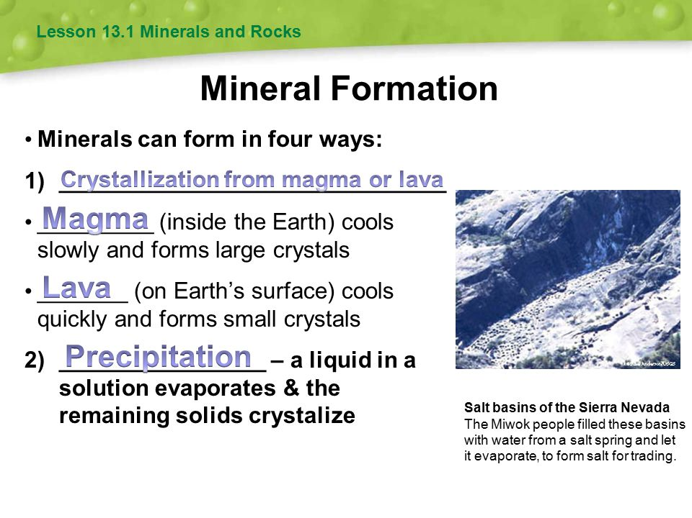

Slide 99
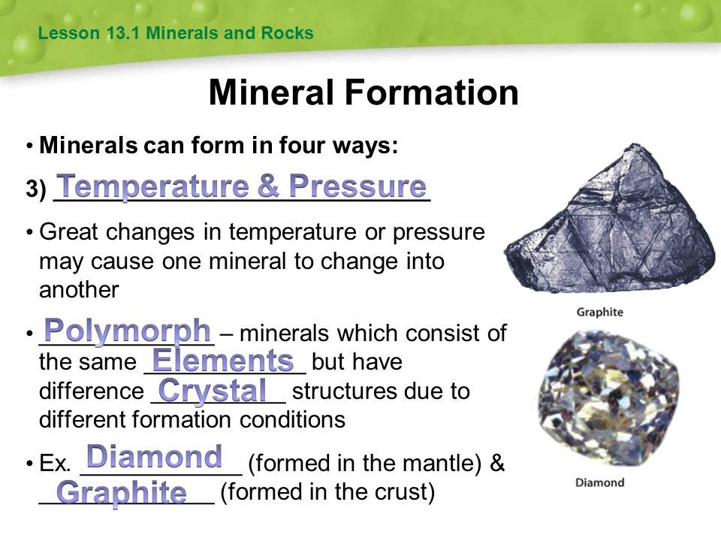

Slide 100
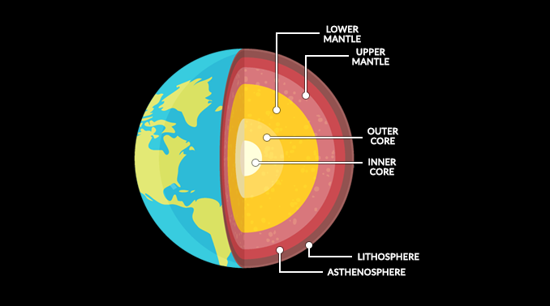

Slide 101
An ore is a mineral or combination of minerals from which a useful substance, such as a metal, can be extracted and used to manufacture a useful product. Ex - gold ore, iron ore etc.
Based on their properties, minerals are basically of two types:
(i) Non metallic minerals e.g. graphite, diamond, quartz, feldspar.
(ii) Metallic minerals e.g. Bauxite, laterite, hematite etc.

Slide 102
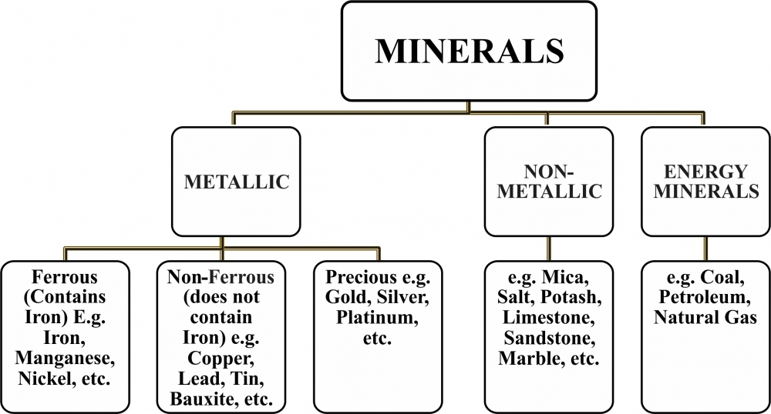

Slide 103
METALLIC MINERALS
Metallic minerals are extracted from mineral deposits and produced by geological processes.
Some metallic minerals contain valuable metals, such as copper, gold, nickel, lead, zinc or platinum.
NON-METALLIC MINERALS
Non-metallic minerals are minerals that do not contain metal.
Physically, they are very volatile and have low elasticity.
Chemically, they have high ionization energy.
Examples of non-metallic minerals include sulphur, phosphorus, iodine, carbon, selenium, limestone, dolomite, gemstones, clay and mica.

Slide 104


Slide 105


Slide 106
ASSOCIATED PROBLEMS, USE AND EXPLOITATION
Environmental effects of extracting and using minerals.
Conservation Strong dependence of industry and agriculture upon mineral deposits and the substances manufactured from them e.g. metallurgical industries, cement industries , pharmaceutical industries. Fertilizers, pesticides, etc.
The total volume of workable mineral deposits is an insignificant fraction i.e. 1% of the earth’s crust.
Recycling of metals using scrap metals and other substitutes are steps in conserving our mineral resources for the future.
Improved technologies need to be constantly evolved.

Slide 107
USES AND EXPLOITATION OF MINERALS
1. Development of industrial plants and machinery - Fe, Al & Cu
2. Construction work – Iron(Fe), Aluminum (Al) & Nickel (Ni)
3. Generation of energy - coal, lignite, uranium
4. Designing defense equipment's like weapons and ornaments
5. Agricultural purposes – fertilizers and fungicides – i.e. Zineb -containing Zinc(Zn) & Maneb - containing Manganese (Mn)
6. Jewellery – Gold (Au), Silver (Ag), Diamond (C) & Platinum (Pt)
7. Making alloys for various purposes – Steel, Bronze, Brass
8. Communication purposes – telephone, wires, cables and electronic devices
9. Medicinal purposes - particularly in ayurvedic system

Slide 108


Slide 109


Slide 110


Slide 111
MINING
Extraction of minerals from earth’s interior is called MINING.
Mining operation done in Four stages
Prospecting : Searching for minerals.
2) Exploration : Assessing the size, shape , location and the economic value of the deposit.
3) Development : Work of preparing the access to the deposit so that the minerals can be extracted.
4) Exploitation : Extracting the minerals from the mines.

Slide 112
ENVIRONMENTAL DAMAGES CAUSED BY MINING ACTIVITIES
1. Devegetation:
Topsoil and vegetation get removed
Deforestation leads to several ecological losses
Land scape gets badly affected
2. Ground water contamination: Mining pollutes ground water; sulphur is converted into sulphuric acid which enters into the soil.
3. Surface water pollution: Radioactive wastes and other acidic impurities affect the surface water, which kills many aquatic animals.
4. Air pollution: Smelting and roasting are done to purify the metal which emits air pollutants and damage the nearby vegetation. It causes many health problems.
5. Subsidence of land: Mainly underground mining results in cracks in houses, tilting of buildings and bending of rail tracks.

Slide 113
EFFECTS OF OVER EXPLOITATION OF MINERALS
1. Rapid depletion of mineral deposits
2. Wastage of upper soil layer and vegetation
3. Environmental pollution
4. Needs heavy energy requirements.
5. Deforestation and desertification
6. Extinction of species
7. Forced migration
8. Soil erosion and oil depletion
9. Ozone depletion
10. Greenhouse gas increase
11. Natural hazards, etc.

Slide 114
MANAGEMENT OF MINERAL RESOURCES
1. The efficient use and protection of mineral resources.
2. Modernization of mining industries.
3. Search for new deposit.
4. Reuse and recycling of the metals.
5. Environmental impacts can be minimized by adopting eco friendly mining technology.

Slide 115
Conservation of Mineral Resources
The total volume of consumable mineral resources is just 1% of all the minerals present in the earth’s crust.
However, the consumption rate is so high that these mineral resources which are non-renewable will get exhausted very soon.
Some measures to conserve minerals:
Use of minerals in a planned and sustainable manner.
Recycling of metals.
Use of alternative renewable substitutes.
Technology should be improved to use the low-grade ores profitably.

Slide 116
CASE STUDIES-MINING AND QUARRYING IN UDAIPUR
200 open cast mining and quarrying in Udaipur.
But 100 mines are illegal.
150 tons of explosives are used per month.
It pollutes air, soil and water.
It affects irrigation and wild life.

Slide 117
4. FOOD RESOURCES
Food is an essential requirement for survival of life.
Main components are carbohydrates, fats, proteins, minerals and vitamins.
TYPES OF FOOD SUPPLY
1. Crop plants: Grains mostly constitute about 76% of the world’s food. Ex: Rice, Wheat and Maize
2. Range lands: Produces 17% of world’s food from trees and grazing animals. Ex: Fruits, milk and meat
3. Ocean: Fisheries – 7% of world’s food

Slide 118
WORLD FOOD PROBLEM
In the earth’s surface, 79% is water out of total area. 21% land (forest, desert, mountain and barren land) . Less % cultivated land, at the same time population explosion is high therefore world food problem arises.
Environmental degradation like soil erosion, water logging, water pollution, salinity affects agricultural land.
3. Urbanization affects agricultural land. Hence production of rice, wheat, corn and other vegetable is difficult.

Slide 119
TYPES OF NUTRITION
1. Nutritious nutrition:
To maintain good health and disease resistance, we need large amount of carbohydrate, proteins, fats and smaller amount of micronutrients such as vitamins and minerals such as Fe, Ca and iodine.
Food and agricultural organization (FAO) of United Nations estimated that on an average, the minimum calorie intake on a global state is 2500 calories/day.
2. Under nutrition:
People who cannot buy enough food to meet their basic energy needs suffer from under nutrition.
They receive less than 90% of this minimum dietary calorie.
Effect of under nutrition: Suffer from mental retardation and infectious diseases.
3. Mal nutrition:
Besides minimum calorie intake we also need proteins, minerals, vitamins, iron and iodine.
Deficiency leads to malnutrition resulting in several diseases.

Slide 120
Effect of mal nutrition:
India 3rd largest producer of crops, nearly 300 million Indians are still under nourished (provide with the food or other substances necessary for growth, health, and good condition).
World food summit 1996:
The world food summit, 1996 has set the goal to reduce the number of under nourished and mal nourished people to just half by 2015.
S.No | Deficiency of nutrients | Effects
1 | Protein | Growth
2 | Iron | Anemia
3 | Iodine | Goiter
4 | Vitamin – A | Blindness

Slide 121


Slide 122


Slide 123


Slide 124
OVER GRAZING
It is a process of eating the forest vegetation without giving a chance to regenerate.
EFFECTS OF OVER GRAZING
Land degradation
Over grazing removing the cover of vegetation.
Exposed soil gets compacted.
Soil moisture reduces.
Desertification - OG leads to poor, dry and compacted soil.
Land cannot be used for further cultivation.
2. Soil erosion: When the grasses are removed the soil becomes loose and gets eroded by the action of wind and rain fall.
3. Loss of useful species: OG affects the plant population and their regenerating capacity. OG replace the plant of high nutritive value with plant of low nutritive value.

Slide 125
AGRICULTURE
Agriculture is an art, science and industry of managing the growth of plants animals for human use.
It includes cultivation of the soil, growing and harvesting crops, breeding and raising livestock, dairying and forestry.
TYPES OF AGRICULTURE
Traditional agriculture
Modern (or) industrialized agriculture
1. Traditional agriculture
Small plot, simple tools, surface water, organic fertilizer and a mixture of crops constitute traditional agriculture. They produce enough food to feed their family and to sell it for their income.
2. Modern agriculture
Hybrid seeds of single crop variety, high tech equipments, lot of fertilisers, pesticides and water to produce large amount of single crops.

Slide 126
EFFECTS OF MODERN AGRICULTURE
1. Problems in using fertilizers
Excess of fertilizers:
causes micronutrient imbalance. (e.g) Punjab and Haryana deficiency of nutrient zinc in the soil affect the productivity of the soil.
b. Blue baby syndrome (nitrate pollution):
Nitrate present in the fertilizer causes blue baby syndrome, when the amount exceeds the limit leads to death.
c. Eutrophication:
Nitrogen and phosphorus in the crop fields washed out by runoff water in the water bodies, which increases the nourishment of the lakes called eutrophication.
Hence algal species increases rapidly. Life time of the species is less and they decompose easily and pollute the water which affects the aquatic life.

Slide 127
2. Problems in using pesticides
Death of non target organism.
Producing new pest – super pest
Bio magnification – Most of the pesticides are non bio degradable, keep on concentrating in the food chain and it is harmful to human beings.
Risk of cancer:
  It directly acts as carcinogen.
  It indirectly supports immune system.
3. Water logging: Land where water stand for most of the year.
Causes of water logging:
(1) Excessive water supply (2) Heavy rain (3) Poor drainage
Remedy:
1. Preventing excessive irrigation
2. Subsurface drainage technology
3. Bio drainage like trees like Eucalyptus

Slide 128
CASE STUDY- PESTICIDES IN INDIA
In Delhi the accumulation of pesticide in the body of mother causes premature delivery and low birth weight infant.
Pesticides in Pepsi and Coca Cola India has reported that Pepsi and coca cola companies are selling soft drinks with pesticide content 30-40 times higher than EU (European Union) limits. This damages the nervous system.

Slide 129
5. ENERGY RESOURCES
ENERGY DISTRIBUTION IN THE WORLD
Developed countries like USA and Canada constitute only 5% of the world’s population but consume 25% of the world’s available energy.
Energy consumed by a person in a developed country for a single day is equal to energy consumed by a single person in a poor country for one year.
Developed country GNP (Gross National Product) increases and energy consumption increases. In the poor country GNP and energy consumption are less.

Slide 130
TYPES OF ENERGY RESOURCES:
Renewable energy resources (or) Non conventional energy resources (or) Inexhaustible energy resources
Non renewable energy resources (or) Conventional energy resources (or) Exhaustible energy resources
1. RENEWABLE ENERGY SOURCES:
Energy which can be regenerated.
Merits of renewable energy resources:
Unlimited supply.
Provides energy security.
Fits into sustainable development concept.
Reliable and the devices are modular in size.
Decentralized energy production.

Slide 131


Slide 132


Slide 133


Slide 134
Types of renewable energy resources
SOLAR ENERGY:
Nuclear fusion reaction of SUN produces enormous amount of energy.
Several techniques are available for collecting, storing and using solar energy.
Solar cell (or) Photovoltaic cell (or) PV cell:
Solar cell consists of p- type semi conductor (Si doped with B) and n-type semi conductor (Si doped with P).
P-type forms top layer and N-type forms bottom layer.
Solar rays fall on the top layer, the electrons from valence band promoted to the conduction band which crosses the p-n junction into n-type semi conductor.
Potential difference between the two layers is created which causes flow of electrons.

Slide 135

USES: It is used in calculators, electronic watches, street light, water pumps etc.
b. Solar battery: Large number of solar cells connected in series is called solar battery. It is used in remote areas where continuous power supply is a problem.
c. Solar water heater: It consists of insulated box painted with black paint with glass lid. Inside the box black painted copper coil is present. Cold water is allowed to flow, it is heated up and flows out into a storage tank from which water is supplied through pipes.

Slide 136


Slide 137


Slide 138


Slide 139
BOX-TYPE SOLAR COOKERS
Box-type solar cookers consists of an insulated box, metallic cooking pots inside the box, double glass lid on the cooking tray, and a reflecting mirror fitted on the underside of the lid of the box.
The heat is absorbed by the blackened surface and gets transferred to the food inside the pots to facilitate cooking.
The life of this cooker is up to 15 years.
This single reflecting cooker can save 4 to 5 LPG cylinders every year.
The costs is around Rs 1000/- after subsidy and is widely available in market.

Slide 140


Slide 141





Slide 142
PARABOLIC CONCENTRATING SOLAR COOKER
Parabolic solar cookers use a parabolic-shaped reflector to direct sunlight to a small area in order to generate heat for cooking.
They are able to reach high temperatures, 350 °C (662 °F) or higher, which allows them to be used for grilling and frying.
The light from the sun is actually focused at the container which gets heated thereby cooking the food.
Solar cooker works on the principle to convert sun light into heat energy and the heat energy trapped is used for cooking.

Slide 143


Slide 144


Slide 145





Slide 146


Slide 147
There are four basic types of solar cookers – panel cookers, box cookers (sometimes called box ovens), parabolic cookers, and tube cookers.
Each of these basic types of solar cookers meet a specific need and specific type of cooking.
ADVANTAGES OF SOLAR COOKING
Solar cooking is free.
Solar cooking is quick and easy.
Food cooked with a solar cooker is healthy.
Solar cooked food tastes amazing!
Solar cookers make no noise.
Cooking with sunshine is kind to the environment.
Solar cooking ovens are portable.
It's rewarding for the whole family.

Slide 148
DISADVANTAGES OF SOLAR COOKER
Disadvantage of a solar cooker is that
It is very expensive.
It does not work without sunlight.
Hence, on cloudy day, it becomes useless.
The places where the days are too short or places with cloud covers round the year, have limited utility for solar cooker.

Slide 149
2. WIND ENERGY
Moving air is called wind.
The energy recovered from the force of the wind is called wind energy when it’s speed is high.
WIND MILLS:
When a blowing wind strikes the blade of the wind mill, it rotates continuously.
And rotational motion of the blade drives number of machines like water pump, flour mills and electric generators.
B. WIND FARMS:
When a large number of wind mills or wind tubines are installed and joined together in a definite pattern – it forms wind farm. It produces large amount of electricity.
Condition: Minimum speed for wind generator is 15 Km/hr.

Slide 150


Advantages:
It does not cause air pollution.
Very cheap.
a. Wind Mill b. Wind Farm

Slide 151
3. OCEAN ENERGY
a. Tidal energy (or) Tidal power:
Ocean tides are due to gravitational force of sun and moon which produce enormous amount of energy.
High tides – rise of water in the ocean.
Low tides – fall of water in the ocean.
Tidal energy can be used by constructing a tidal barrage.
During high tides sea water enters into the reservoirs and rotates the turbine, produce electricity.
During low tides water from reservoir enters into the sea rotate the turbine produce electricity.

Slide 152



Slide 153
b. Ocean thermal energy:
Temperature difference between surface water and deeper level water in ocean generates electricity.
The energy available due to the difference in temperature of water is called ocean thermal energy.
Condition: Temperature difference should be 200 C.
Process:
Ammonia is converted into vapours on the surface of warm water, it increases the vapour pressure which rotate the turbine and generates electricity.
Deeper level cold water is pumped to cool and condense the vapour in to liquid.

Slide 154



Slide 155
4. GEO THERMAL ENERGY
Temperature of the earth increases at a of 20 –750◦C per/km when we move down the earth.
The energy utilised from the high temperature present inside the earth is called geothermal energy (is heat derived within the sub-surface of the earth).
Water and/or steam carry the geothermal energy to the Earth's surface.
Depending on its characteristics, geothermal energy can be used for heating and cooling purposes or be harnessed to generate clean electricity.
Natural geysers: Hot water or steam comes out of the ground through cracks naturally is called natural geysers.
Artificial geysers: Artificially a drill hole up to the hot region and by sending a pipe into it. The hot water or steam is used to rotate the turbine and generate electricity.

Slide 156



Slide 157
5. BIO MASS ENERGY
Bio mass:
Organic matter produced by plants or animals used as source of energy.
Bio gas:
Mixture of methane (CH4), carbondioxide (CO2) and hydrogen sulphide(HS).
Methane is the major constituent.
It is obtained by anerobic fermentation of animal dung (or) plant wastes in the presence of water.
Bio fuels: Fuels obtained by the fermentation of biomass. Ex: Ethanol, methanol.

Slide 158

Ethanol: Produced from sugar cane. Calorific value is less.
Methanol: Obtained from ethanol. Calorific value too less.
Gasohol: Mixture of ethanol and gasoline. India trial is going on to use gasohol in cars and buses.
Hydrogen fuel: Hydrogen produced by pyrolysis, photolysis and electrolysis of water. It has high calorific value. Non polluting one because the combustion product is water.
Disadvantages: 1. Hydrogen is highly inflammable and explosive. 2. Safe handling is required. 3. Difficult to store and transport.

Slide 159
2. NON RENEWABLE ENERGY SOURCES
Energy which cannot be regenerated is called as non-renewable.
Coal: It is a solid fossil fuel.
Disadvantages:
When coal is burnt large amount of CO2 is released which causes global warming.
Sulphor, Nitrogen produces toxic gases during burning.
2. Petroleum:
Crude oil is a liquid consists of more than hundreds of hydrocarbons and small amount of impurities.
The petroleum can be refined by fractional distillation. In the world level 25% of oil reserves are in Saudi Arabia.
At present rate of usage, the world crude oil reserves are expected to get exhausted in just 40 years.

Slide 160
3. Liquefied Petroleum Gas (LPG):
Petroleum gases obtained during FD (fractional distillation) and cracking can be easily converted into liquid under high pressure as LPG.
It is colorless and odorless gas, but during cylindering mercaptans (foul-smelling gas) are added to detect leakage.
4. Natural gas:
These are found above oil in oil wells. It is a mixture of methane and other hydrocarbons.
Calorific value is high.
There are two types. Dry gas and wet gas.
5. Nuclear energy:
Dr. Homi Bhabha is a father of nuclear power development in India. 10 nuclear reactors are present in India.
It produces 2% of India’s electricity.
Nuclear energy can be produced by two types of reactions.
Nuclear fission and Nuclear fusion.

Slide 161
Nuclear fission:
It is a nuclear change in which heavier nucleus split into lighter nuclei on bombardment of fast moving neutrons.
Large amount of energy is released through chain reaction.
Ex: Uranium with fast moving neutron gives barium and krypton in addition to three neutrons; in the second stage it gives nine neutrons and so on.
This process of propagation of the reaction by multiplication is called chain reaction.
Nuclear fusion:
It is a nuclear change in which lighter nucleus is combined together at extremely high temperature (1 billion 0C) to form heavier nucleus and a large amount of energy is released.
Ex: Isotopes of hydrogen combine to form helium molecule.

Slide 162


Slide 163


Slide 164
CASE STUDY
Wind energy in India:
India generating 1200 MW electricity using the wind energy.
Largest wind farm situated near Kanyakumari in Tamilnadu.
It produces 380 MW electricity.
Hydrogen fuel car:
General motor company of China discovered a experimental car ( fuel H2) can produce no emission only water droplets and vapors come out of the exhaust pipe.
This car will be commercially available by 2010.

Slide 165
6. LAND RESOURCES
Land as a Resource
Land area constitutes about 1/5 of the earth surface.
To meet out the challenging demand of food, fibre and fuel for human population, fodder for animals and industrial raw material for agro based industries, efficient management of land resources will play critical role.
Soil, water, vegetation and climate are basic natural resources for agricultural growth and development.
Land resources are the resources available from the land like:
The agricultural land, the underground water, the various minerals like coal, bauxite, gold and other raw materials.
In a wider sense, land resource can also mean the land available for exploitation, like non agricultural lands for buildings, developing townships etc.

Slide 166


Slide 167


Slide 168
Associated problems
a. Land Degradation b. Soil Erosion (loss of soil nutrients)
A. LAND DEGRADATION
> Due to increasing population, the demands for arable land for producing food, fibre and fuel wood is also increasing.
Hence there is more and more pressure on the limited land resources which are getting degraded due to over-exploitation.
Nearly 56% of total geographical area of the country is suffering due to land resource degradation.
Out of 17 million hectare canal irrigated area, 3.4 million hectare is suffering from water logging and salinity.
Soil erosion, water logging, salinization and contamination of the soil with industrial wastes like fly-ash, press mud or heavy metals all cause degradation of land.

Slide 169
B. SOIL EROSION
Soil erosion refers to loss or removal of superficial layer of soil due to the action of wind, water and human factors.
In other words, it can be defined as the movement of soil components, especially surface-litter and top soil from one place to another.
It has been estimated that more than 5000 million tones topsoil is being eroded annually and 30% of total eroded mass is getting loosed to the sea .
It results in the loss of fertility.
It basically is of two types, viz.
(a) geologic erosion and
(b) accelerated erosion.

Slide 170
Various factors which affect soil erosions include soil type, vegetation cover, slope of ground, soil mismanagement and intensity and amount of rainfall.
Wind is also responsible for the land erosion through saltation, suspension and surface creep.
The characteristics of natural ecosystems such as forests and grasslands depend on the type of soil.
Deforestation thus leads to rapid soil erosion. Soil erosion is one form of soil degradation.
The erosion of soil is a naturally occurring process on all land.
Soil erosion may be a slow process that continues relatively unnoticed, or it may occur at an alarming rate causing a serious loss of topsoil.

Slide 171




CAUSES OF SOIL EROSION
There are many different factors that can cause soil erosion, most can be broken down into two main categories:
a. Erosion by Water b. Erosion by Wind

Slide 172





Slide 173
Conservation of soil erosion
In order to prevent soil erosion and conserve the soil the following conservation practices are employed,
Conservational till farming, Contour farming and Terracing
Strip cropping and alley cropping
Wind breaks or shelterbelts
By educating, informing and sensitizing all landholders about various aspects of this precious resources and their sustainable use.
Contour ploughing is another measure to conserve our land. By this method, the fields are ploughed, harrowed and sown along the natural contour of the hills.

Slide 174


Slide 175
By terracing method: A series of wide steps are made along the slope following the contours. This method is very common in rice growing regions.
Under the afforestation and reforestation programs, planting of trees, bushes and grass help to check the soil erosion, Strict actions are taken to check reckless felling of trees and overgrazing, Construction of dams and gully-trap inculcate the water-harvesting.
SALINIZATION
It refers to accumulation of soluble salts in the soil.
Concentration of soluble salts increases due to poor drainage facilities.
In dry land areas, salt concentration increases where poor drainage is accompanied by high temperature.
High concentration of salts affects the process of water absorption hence affects the productivity.

Slide 176
WATER LOGGING
Excessive utilization of irrigation may disturb the water balance which can lead to water logging (saturation of soil with water) due to rise of water table .
Anaerobic condition due to poor availability of oxygen in water logged soils may affect respiration process in plants which will ultimately affect the productivity of water logged soil.
DESERTIFICATION
Desertification is a process whereby the productive potential of arid or semiarid lands falls by ten percent or more.
Desertification is characterized by devegetation and depletion of groundwater, salinization and severe soil erosion.
Causes of desertification
Deforestation
Overgrazing
Mining and Quarrying

Slide 177


SHIFTING CULTIVATION
Shifting cultivation is a practice of slash and burn agriculture adopted by tribal communities and is a main cause for soil degradation particularly tropical and sub tropical regions.
Shifting cultivation which is also popularly known as ‘Jhum Cultivation’ has lead to destruction of forest in hilly areas .
It is responsible for soil erosion and other problems related to land degradation in mountainous areas.

Slide 178


MAN INDUCED LANDSLIDES
Human race has exploited land resources for his own comfort by constructing roads, railway tracks, canals for irrigation, hydroelectric projects, large dams and reservoirs and mining in hilly areas.
Moreover productive lands under crop production are decreasing because of development activities.
These factors are affecting the stability of hill slopes and damage the protective vegetation cover.
These activities are also responsible to upset the balance of nature and making such areas prone to landslides.

Slide 179


Slide 180


Slide 181
ROLE OF INDIVIDUAL
IN CONSERVATION OF
NATURAL RESOURCES
Every individual has a role in the conservation of natural resource like in using water, electricity, woods, foods, energy, minerals, etc.
water is life and every drop is precious similarly every chemical power saved is like it is produced.
The responsibility for conserving our resources lies with everyone, from the individual, to developing countries, to developed countries.
Countries can come together to form a legally binding agreement, and individuals can conserve their water and energy use.

Slide 182
Why We Conserve Natural Resources?
Human beings depend upon the natural resources for their development activities.
If the resources are not used wisely, it would create an imbalance in the environment.
Thus would head us in opposition to an eco-friendly atmosphere.
The need for conservation arises from the significance of natural resources.
It is as follows-
Water is a renewable natural resource. We use it for drinking, producing electricity, irrigation, in various industries and for a number of activities. Its scarcity would cause loss of vegetation, adverse effect on flora and fauna, erosion of soil, etc.

Slide 183
2) Plants and animals provide a wide range of industrial and biological materials. Also, it assists in the manufacturing of medicine and for various other uses.
3) It takes millions of years for the formation of natural resources.
4) Fossil fuels are of great importance. A lot of energy is produced from coal, oil and natural gas all of which are fossil fuels.
5) Forest is the most important natural resource which helps in economic development. Forest provides paper, furniture, timber, medicine, gum, etc. Also, it maintains a balance in the ecosystem. Moreover, it prevents soil erosion and protects wildlife.
6) Land resources support natural vegetation, wildlife, transport. The land also provides us food, cloth, shelter, and other basic needs.

Slide 184
Ways to Conserve Natural Resources
Different ministries of the Government, national and international agencies have been working for the purpose of conserving the natural resources
Environment education must be imparted by including the same in the curricula of the schools.
National Parks are making an effort for the safety of the natural resources.
By reducing, reusing and recycling of non-renewable resources.
Non-human species must be disturbed only to meet the basic needs.
Planting of more and more trees to save our forest resources.
Seeking alternatives to non-renewable resources.

Slide 185
7) By increased use of bio-gas and bio-fuels.
8) By preventing the dumping of industrial wastes into the river bodies. This is a measure to protect the rich marine life.
9) Overgrazing must be prevented. Also, poaching of animals must be controlled.
10) Practicing crop rotation techniques helps in maintaining the fertility of the soil.
11) Burning of fossil fuels emits carbon-di-oxide which is a major greenhouse gas. It is responsible for the greenhouse effect. Thus, the burning of fossil fuels must be controlled.

Slide 186
These are some of the measures which we can undertake for the conservation of natural resources.
As Human- beings, we have a social responsibility to fulfill towards nature.
Thus, while using resources, we shall follow the principle of sustainable development.
CONCLUSION
Natural resources are a present for the creation.
These help in satisfying the human needs to its fullest.
Furthermore, the rational use of natural resources maintains the earth’s atmosphere.
Also, the wise use leads to protection of bio-diversity.
Humans cannot imagine their lives without natural resources.
Thus, the conservation of the same is essential.

Slide 187
EQUITABLE USE OF RESOURCES FOR SUSTAINABLE LIFESTYLES
Scarcity of resources is the burning problem of modern technology. The twenty-first century will see growing human needs for resources since many parts of the world are using natural resources at a rate faster than the natural processes can replenish it.
There are several principles that each of us can adopt bring about sustainable lifestyles.
Reduction of the unsustainable and unequal use of resources, and control of our population growth.
Expand green grassland.
The clean water of a lake that supports so much life.
Magnify power of the Oceans.

Slide 188
Natural resources are limited. For example, the existing water sources are being subjected to heavy pollution.
Global climatic changes are altering the quality of fresh water sources as a consequence of unknown effects on the hydrological cycle.
Sustainable development is currently being discussed as a focal theme in the field of development, planning and other associated aspects.
In the light of self-defeating current mode of development and recurrent natural calamities, people are urged to ponder over the faults, shortcomings, lacunae, discrepancies and limitations of the ongoing developmental process and production system.
It is essential to sustain the natural resources. We should conserve natural resources so that it may yield sustainable benefit to the present generation while maintaining its potential to meet the needs of the future generation.

Slide 189
There are three specific objectives to conserve living resources:
To ensure that any utilisation of the ecosystem is sustainable.
2. To preserve biodiversity and
3. To maintain essential ecological processes.
Resource management should be less energy-intensive, suitable to local ecology and needs of the people, less cost-intensive and more viable in terms of economy, ecology and culture.

Slide 190
The Srilankan team, for example studied traditional paddy irrigation systems as a model for water management.
Its reports note that from the 5th century B.C. through the 12th century A.D., Sri Lanka developed a technologically advanced civilization based on an intricate system of rainwater conservation and irrigation.
Water users were collectively and individually responsible for maintenance of the irrigation systems and customary laws, known as Sirit, were established governing water use and related aspects of life.
Similarly, the italics system is a system of farmer-managed canal irrigation, which has been in operation for more than 300 years in Dhule, and Nasik district of northwestern Maharashtra.

Slide 191
SUSTAINABLE RESOURCE USE
The research focus of “Sustainable Resource Use” is on promoting efficient and sustainable use of natural resources in order to secure the availability of food, animal feed and renewable raw materials while maintaining soil fertility and the supply of clean drinking water.
The researchers investigate the underlying processes which are essential for the sustainable use of resources – from the molecular scales up to the level of ecosystems and landscapes – as well as their resilience against changing abiotic and anthropogenic influences.
This is done through a combination of research approaches from the fields of biophysics, engineering, socio-​economics and political science.
For this purpose, natural sciences, engineering and political science are combined with socio-​economic research approaches.

Slide 192





Slide 193



