Slide 1

THEORY - 1
ENTREPRENEURSHIP and MANAGEMENT & SMART TECHNOLOGY
5TH SEMESTER, MECHANICAL
Prepared by :-
SAROJ KUMAR SAHU
Lecturer in Mechanical Engineering
U.G.M.I.T., Rayagada

Slide 2
Chapter – 2
MARKET SURVEY and OPPORTUNITY IDENTIFICATION (BUSINESS PLANNING)
BUSINESS PLANNING
Business plan is a written document that outlines the future activity for an existing or proposed business venture.
A business plan basically is a blue print.

Slide 3
A Business plan is the formal written expression of the entrepreneurial vision, describing the strategy and operations of the proposed venture.
A business plan is a document that brings together the key elements of a business that include details about the products and services, the cost, sales and expected profits.
“Business plan is a written document that describes all the relevant internal and external elements involved in starting a new venture.”
It is the road map for operating any business and progress along the way.

Slide 4
A business plan is a written document that describes in details how a new business is going to achieve its goal.
A business plan layout a written plan from a marketing, financial and operational viewpoint.
A business plan is a written description, typically 25 to 35 pages long, that describes what a new business idea/ plan to accomplish.
DUAL-PURPOSE DOCUMENT
For most new ventures, the business plan is a dual-purpose document used for both inside and outside the firm.

Slide 5
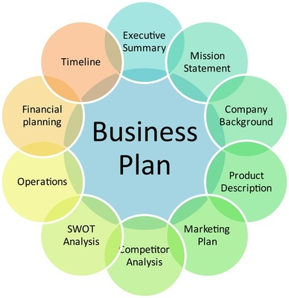

Slide 6
PURPOSE OF A BUSINESS PLAN
Alignment of team(s).
Operating plan.
Communication across company, division, department, business partner.
Investment capital.
Expansion capital (banks, leases).
Merger / acquisition process.

Slide 7
BENEFITS/REASON FOR WRITING A BUSINESS PLAN
Initial planning documents for a new business.
Serves as a tool to communicate the idea of the new venture to potential investors, bankers, key employees.
Serves as a record to monitor and compare results.
To obtain bank financing.
To obtain investment funds.
To establish strategic alliances.
To obtain initial contracts.
To attract key employees.
To motivate and focus your management team.

Slide 8
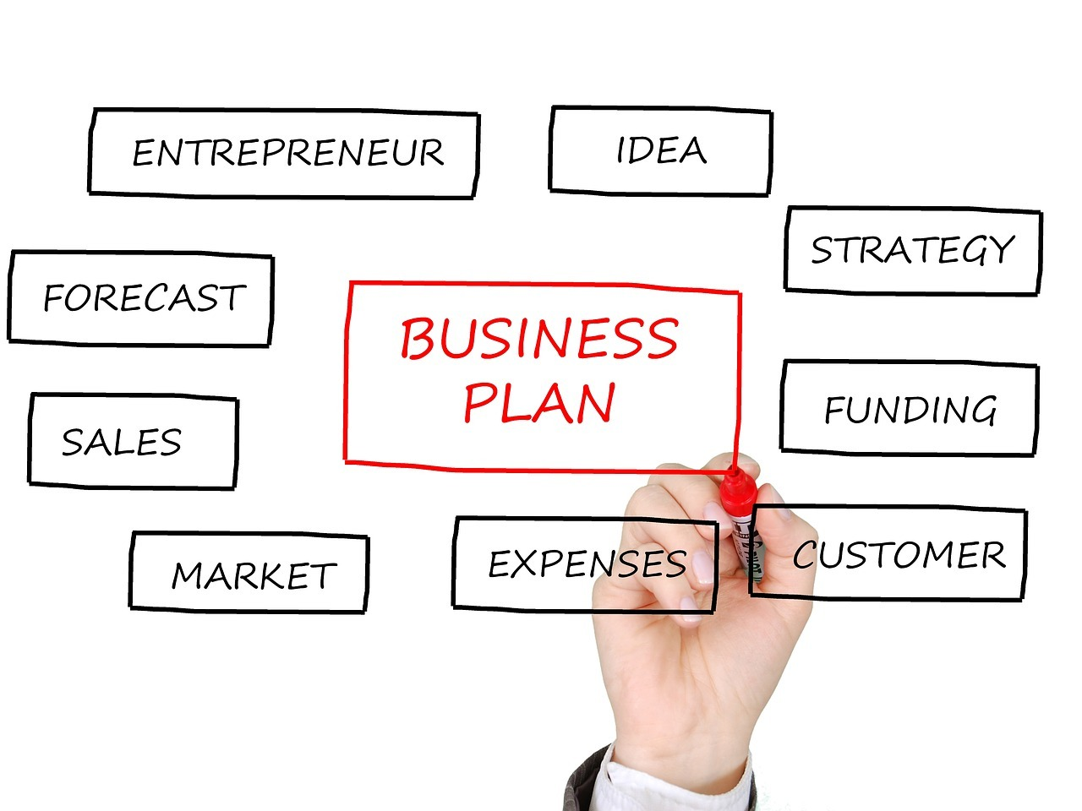

Slide 9
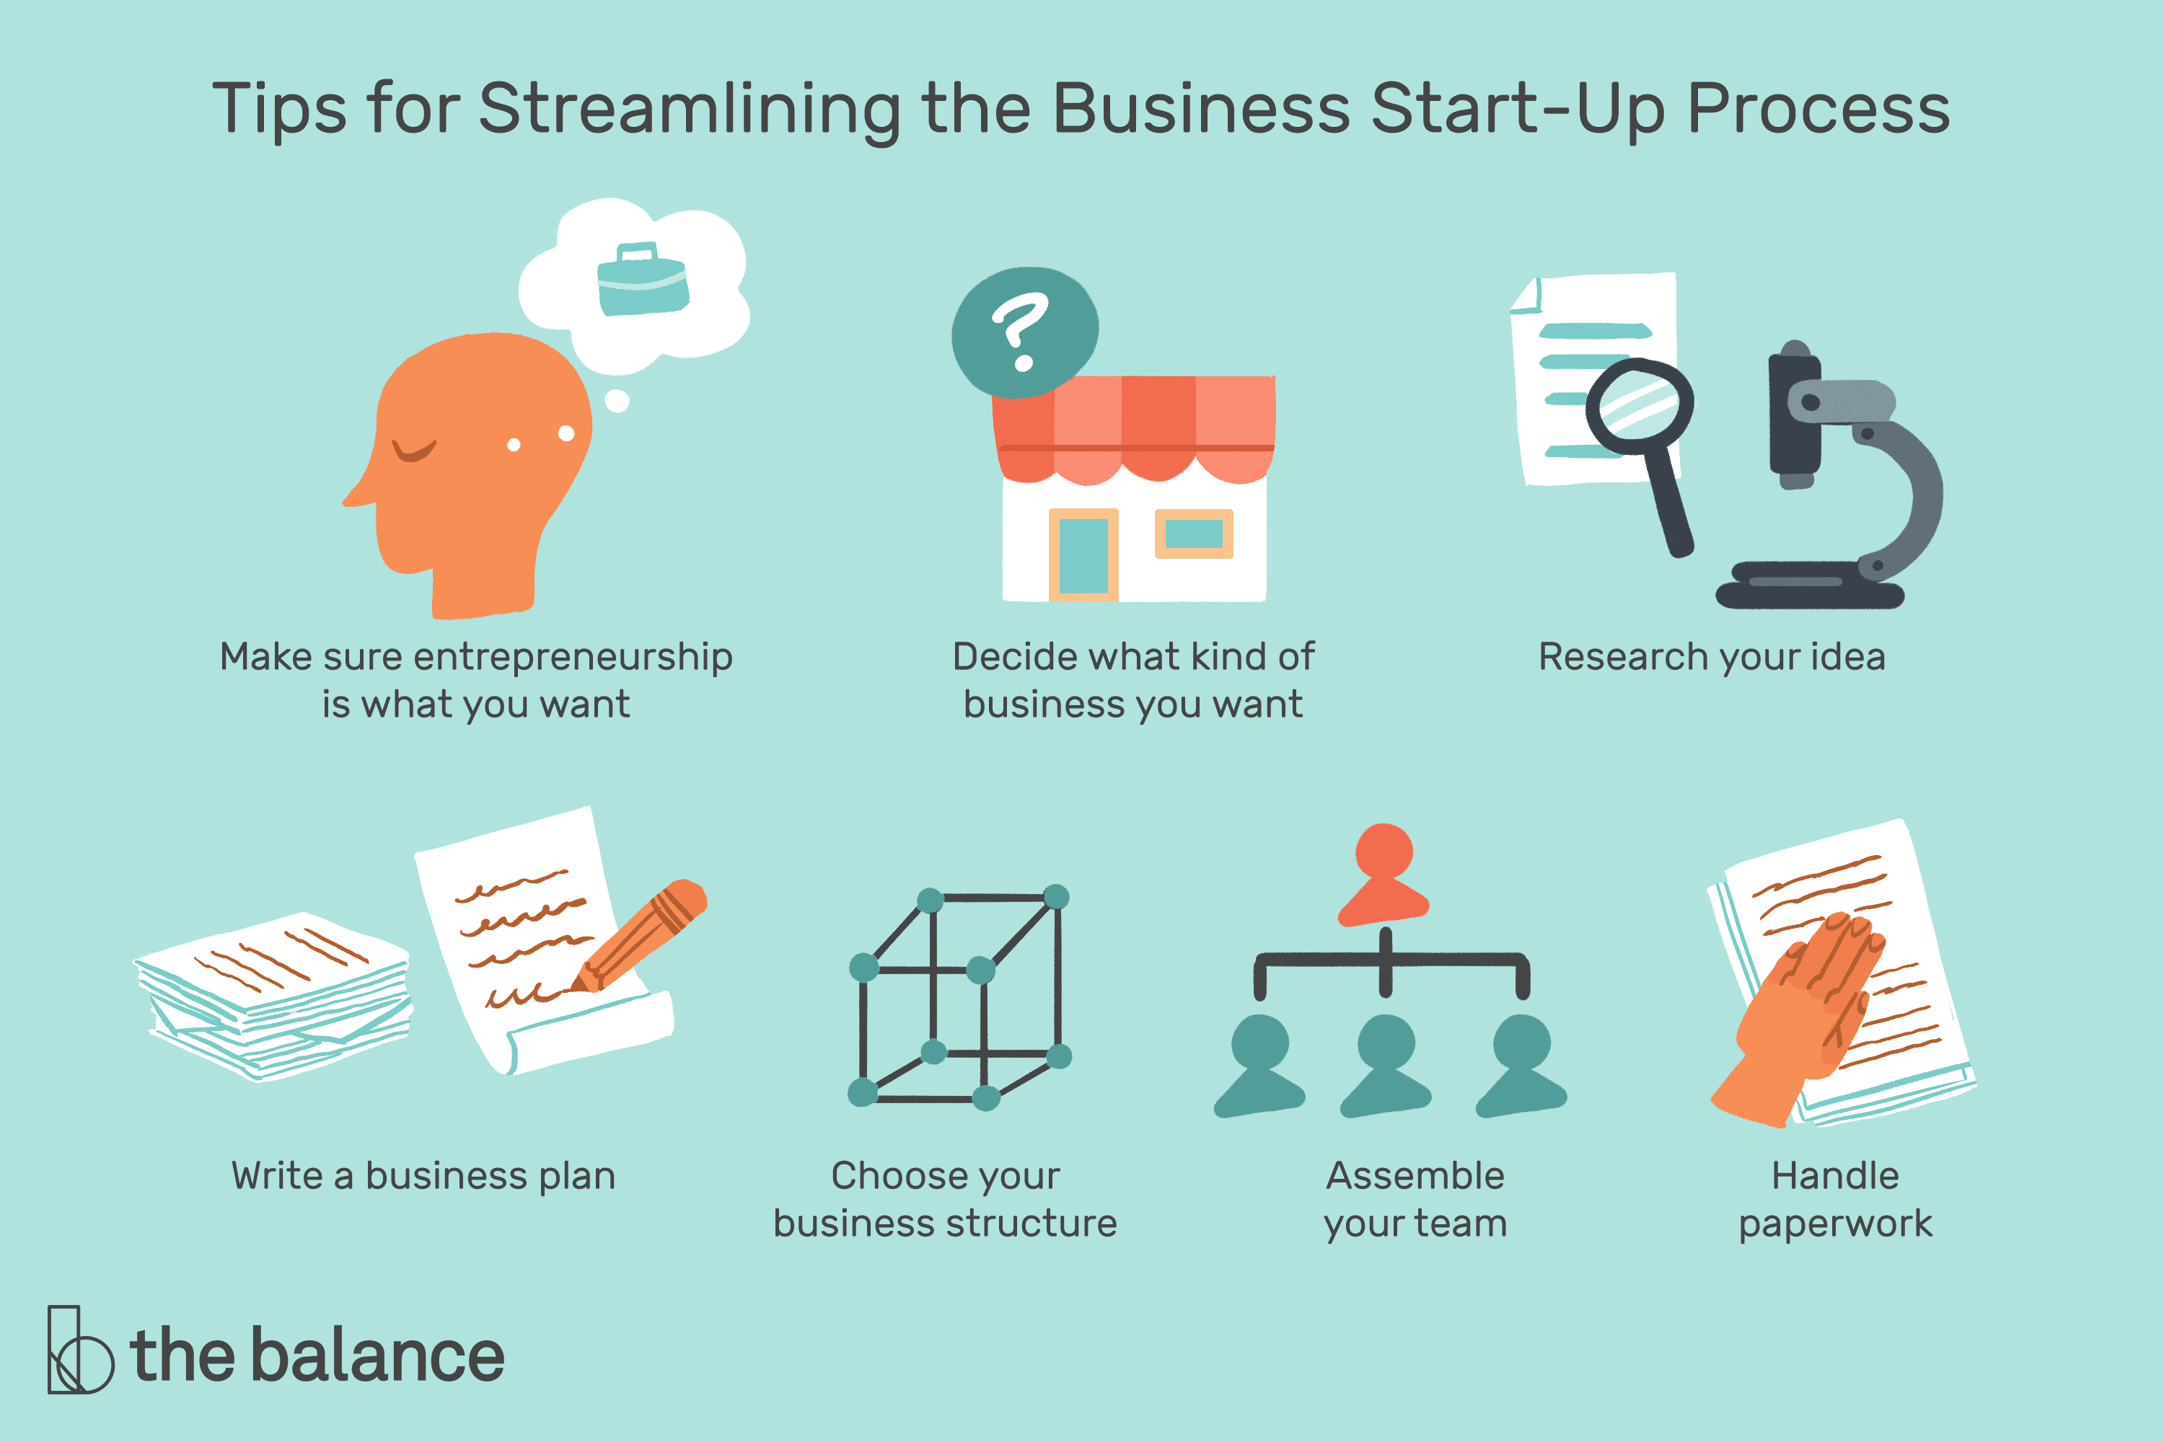

Slide 10
SMALL SCALE INDUSTRIES ( SSI )
Small scale industries (SSI) are those industries in which the manufacturing, production and providing of services are done on a small or micro scale.
These industries make a one-time investment in machinery, plants, and industries, but it does not exceed Rs 1 Crore.
For example, some ideas of Small scale industries are: Napkins, tissues, chocolates, toothpick, water bottles, small toys, papers, pens etc.
Small scale industries play an important role in social and economic development of India.
These industries do a one-time investment in machinery, plants, and industries which could be on an ownership basis, hire purchase or lease basis.

Slide 11
Introduction of SSI
Essentially the small scale industries are generally comprised of those industries which manufacture, produce and render services with the help of small machines and less manpower.
These enterprises must fall under the guidelines, set by the Government of India.
The SSI’s are the lifeline of the economy, especially in developing countries like India.
These industries are generally labour-intensive, and hence they play an important role in the creation of employment.
SSI’s are a crucial sector of the economy both from a financial and social point of view, as they help with the per capita income and resource utilisation in the economy.
Examples and Ideas of Small Scale Industries
Bakeries, School stationeries, Water bottles, Leather belt, Small toys, Paper Bags, Photography, Beauty parlours etc.

Slide 12
Characteristics of SSI
Ownership:
SSI ’s generally are under single ownership.
So it can either be a sole proprietorship or sometimes a partnership.
Management:
Generally both the management and the control is with the owner/owners.
Hence the owner is actively involved in the day-to-day activities of the business.
Labor Intensive:
SSI’s dependence on technology is pretty limited.
Hence they tend to use labour and manpower for their production activities.

Slide 13
Flexibility:
SSI’s are more adaptable to their changing business environment.
So in case of amendments or unexpected developments, they are flexible enough to adapt and carry on, unlike large industries.
Limited Reach:
Small scale industries have a restricted zone of operations.
Hence, they can meet their local and regional demand.
Resources utilisation:
They use local and readily available resources which helps the economy fully utilise natural resources with minimum wastage.

Slide 14
Role in the Indian economy
Employment: SSI’s are a major source of employment for developing countries like India. Because of the limited technology and resource availability, they tend to use labour and manpower for their production activities.
Total Production: These enterprises account for almost 40% of the total production of goods and services in India. They are one of the main reasons for the growth and strengthening of the economy.
Make in India: SSI’s are the best examples for the Make in India initiative. They focus on the mission to manufacture in India and sell the products worldwide. This also helps create more demands from all over the world.
Export contribution: India’s export industry majorly relies on these small industries for their growth and development. Nearly half of the goods that are exported from India are manufactured or produced by these industries.
Public Welfare: These industries have an opportunity to earn wealth and create employment. SSI’s are also important for the social growth and development of our country.

Slide 15
Objectives of SSI
The objectives of the small scale industries are:
To create more employment opportunities.
To help develop the rural and less developed regions of the economy.
To reduce regional imbalances.
To ensure optimum utilisation of unexploited resources of the country.
To improve the standard of living of people.
To ensure equal distribution of income and wealth.
To solve the unemployment problem.
To attain self-reliance.
To adopt the latest technology aimed at producing better quality products at lower costs.

Slide 16
Registration of SSI
SSI registration is provided by the Ministry of MSME.
A business should obtain SSI registration in order to be eligible for a number of schemes, subsidies and other incentives provided by the Government to such SSI’s.
SSI registration can be obtained online too.
Overview of SSI registration
SSI registration is provided by the Ministry of Micro, Small and Medium Enterprises through the Directorate of Industries of the State Government.
The main logic behind the SSI registration is to set up new SSI businesses in India.
SSI registration helps the business to be eligible for a number of subsidies given by the Government.
We can also get SSI registration online.

Slide 17
Eligibility Criteria for SSI registration
SSI registration can be obtained for:
  Manufacturing enterprise and Service enterprise
For manufacturing enterprise,
if the investment in plant and machinery (excluding land & buildings)
is within any of the following levels:
Micro Enterprises: Investment of up to Rs.25 lakhs in plant and machinery
Small Enterprises: Investment of up to Rs.5 crores in plant and machinery
Medium Enterprises: Investment of up to Rs.10 crores in plant and machinery

Slide 18
For service enterprise,
if the investment in plant and machinery (excluding land & buildings)
is within any of the following levels:
Micro Enterprises: Investment of up to Rs.10 lakhs in equipment
Small Enterprises: Investment of up to Rs.2 crores in equipment
Medium Enterprises: Investment of up to Rs.5 crores in equipment
If the investment is done within the above-mentioned limits then the SSI registration has to be obtained.

Slide 19
Benefits of obtaining SSI registration
There are various tax rebates offered to SSI’s
A credit for Minimum Alternate Tax (MAT) is allowed to be carried forward for up to 15 years instead of 10 years.
There are many government tenders which are only open to the SSI.
They get easy access to credit.
Once registered the cost of acquiring a patent, or the cost of setting up the industry reduces as many rebates and concessions are available.
Business registered as SSI are given higher preference for government license and certification.

Slide 20
Business registered as SSI are given higher preference for government license and certification.
To do the registration the SSI owner has to fill a single SSI online registration form.
It can be done in the offline mode as well.
If a person wants to get registration for more than one industry then also he/she can opt for an individual SSI registration done.
To get registered he/she has to fill a single form which is available at the website.
The documents required for the SSI registration are Aadhar number, industry name, address, bank account details and some common information.
Here, the person can provide self-certified certificates.
  No registration fees is required for the registration.
  Once the SSI registration form is filled and uploaded, very soon you will obtain the SSI registration number.

Slide 21
ANCILLARY UNITS
An ancillary unit is the unit which supplies not less than 50% of its production to the parent unit.
Investment limit in such unit is one crore.
TINY UNITS
A tiny unit is the business enterprise whose investment in plant and machinery is not more than 25 lakhs.
Investment limit is 25 lakhs in this type of unit .

Slide 22
TINY UNIT:
1. It is that type in which machinery and investment of plant is not more than 25 lac.
2. Its investment limit is almost 25 lac.
3. There is no assistance required.
4. It cannot do its business by itself.
5. It is of large scale.
ANCILLARY UNIT:
1. It is that type in which its supplies its 50 % production to the parent unit.
2. Its investment limit is almost one crore.
3. There is assistance required from parents by providing technical and financial support.
4. It can do its business by itself.
5. It is of small scale.

Slide 23
SERVICE SECTOR
The Service Sector, also called tertiary sector, is the third of the three traditional economic sectors.
Activities in the service sector include retail, banks, hotels, real estate, education, health, social work, computer services, recreation, media, communications, electricity, gas and water supply.
The service sector produces intangible goods (do not exist in physical form), more precisely services instead of goods, and according to the U.S. Census Bureau,
it comprises various service industries including warehousing and transportation services; information services; securities and other investment services; professional services; waste management; health care and social assistance; and arts, entertainment, and recreation.

Slide 24
Countries with economies centered around the service sector are considered more advanced than industrial or agricultural economies.
The service sector is the third sector of the economy, after raw materials production and manufacturing.
The service sector includes a wide variety of tangible (exist in physical form) and intangible (do not exist in physical form) services from office cleaning to rock concerts to brain surgery.
The service sector is the largest sector of the global economy in terms of value-added and is especially important in more advanced economies.

Slide 25
Instead of the product production, service sector produces services maintenance and repairs, training or consulting.
Examples of service sector jobs include housekeeping, tours, nursing and teaching.
By contrast, individuals employed in the industrial or manufacturing sectors produce tangible goods, such as cars, clothes or equipment.
Among the countries that place heavy emphasis on the service sector, the United States, the United Kingdom, Australia, and China rank among the top.
In the United States, the Institute for Supply Management (ISM) produces a monthly index that details the general state of business activity in the service sector.
This index is regarded as a metric for the overall economic health of the country because approximately two-thirds of U.S. economic activity occurs in the service sector.

Slide 26
TIME SCHEDULE PLAN
BUSINESS PLAN
A business plan is a formal written document containing business goals, the methods on how these goals can be attained, and the time frame within which these goals need to be achieved.
SCHEDULING
Scheduling in project management is the listing of activities, deliverables, and milestones within a project.
A schedule also usually includes the planned start and finish date, duration, and resources assigned to each activity.
Effective project scheduling is a critical component of successful time management.

Slide 27
Scheduling is the art of planning your activities so that you can achieve your goals and priorities in the time you have available.
When it's done effectively, it helps you: Understand what you can realistically achieve with your time.
Make sure you have enough time for essential tasks.
SCHEDULE PLAN
A plan for performing work or achieving an objective, specifying the order and allotted time for each part.
Finished the project on schedule.
A printed or written list of items in tabular form.

Slide 28
TIME FRAME FOR A BUSINESS PLAN
Typical business plans, however, tend to use one-year, three-year, or five-year benchmarks. (Odd numbers are popular, for some reason.)
Business planning is an ongoing process.
From year to year — and sometimes more often than that — companies review, revise, and even completely overhaul their plans.
EFFECTIVE SCHEDULING
Planning to Make the Best Use of Your Time:
It's the end of another busy working day and, even though you came into the office early and left late, you don't feel as if you've accomplished anything significant.

Slide 29
It's all too easy for this to happen. Faced with endless meetings, frequent interruptions, and urgent last-minute tasks, you can easily be busy all day without making any progress on high-priority projects and goals.
That's why it's so important to know how to schedule your time properly.
thereby making time for the work that really matters, while still leaving time for personal development, family and friends.
THE IMPORTANCE OF SCHEDULING
Scheduling is the art of planning your activities so that you can achieve your goals and priorities in the time you have available.

Slide 30
When it's done effectively, it helps you:
Understand what you can realistically achieve with your time.
Make sure you have enough time for essential tasks.
Add contingency time for "the unexpected.“
Avoid taking on more than you can handle.
Work steadily toward your personal and career goals.
Have enough time for family and friends, exercise and hobbies.
Achieve a good work-life balance.
Time is the one resource that we can't buy, but we often waste it or use it ineffectively.
Scheduling helps you think about what you want to achieve in a day, week or month, and it keeps you on track to accomplish your goals.

Slide 31
HOW TO SCHEDULE YOUR TIME
Set a regular time to do your scheduling – at the start of every week or month, for example.
There are a number of different tools to choose from.
A simple and easy way to keep a schedule is to use a pen and paper, organizing your time using a weekly planner.
You can also use apps and software such as Google Calendar®, MS Outlook® and Business Calendar.
Choose a scheduling tool that suits your situation, the current structure of your job, your personal taste, and your budget.
The most important thing when choosing your planner is that it lets you enter data easily, and allows you to view an appropriate span of time (day/week/month) in the level of detail that you need.
Once you have decided which tool you want to use, prepare your schedule in the following way:

Slide 32
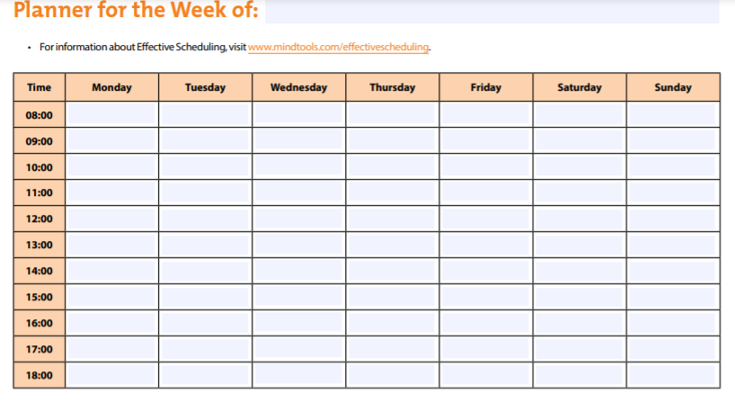

Slide 33
Step 1: Identify Available Time
Start by establishing the time you want to make available for your work.
How much time you spend at work should reflect the design of your job and your personal goals in life.
Step 2: Schedule Essential Actions
Next, block in the actions you absolutely must take to do a good job.
These will often be the things you are assessed against.
Step 3: Schedule High-Priority Activities
Review your To-Do List , and schedule in high-priority and urgent activities, as well as essential maintenance tasks that cannot be delegated or avoided.
Try to arrange these for the times of day when you are most productive.

Slide 34
Step 4: Schedule Contingency Time
Next, schedule some extra time to cope with contingencies and emergencies. Experience will tell you how much to allow – in general, the more unpredictable your job, the more contingency time you'll need. (If you don't schedule this time in, emergencies will still happen and you'll end up working late)
Frequent interruptions can eat into your time. Learning how to manage them can reduce the amount of contingency time you need to set aside. Some interruptions will be hard to predict, but leaving some open space in your schedule gives you the flexibility you need to rearrange tasks and respond to important issues as they arise.
Step 5: Schedule Discretionary Time
The space you have left in your planner is "discretionary time": time that is available to deliver your priorities and achieve your goals. Review your prioritized To-Do List and personal goals, evaluate the time you need to achieve them, &schedule them in.

Slide 35
Step 6: Analyze Your Activities
If, by the time you reach step five, you find that you have little or no discretionary time available, you need to go back through steps two, three and four, and question whether all of the tasks you've entered are absolutely necessary.
It may be that some things can be delegated or tackled in a more time-efficient way.
One of the most important ways that you can build success is by maximizing the leverage you can achieve with your time.
Increase the amount of work you can complete by delegating to other people, outsourcing key tasks, or using technology to automate as much of your work as possible.
This will free you up to achieve your goals.
Use your newly prepared schedule as evidence of your heavy commitments. This demonstrates to your boss how well-organized you are, and might make him or her more receptive to your request.

Slide 36
Key Points
Scheduling is the process by which you plan how you'll use your time. Doing it well can maximize your effectiveness and reduce your stress levels.
Follow this six-step process to prepare your schedule:
Identify the time you have available.
Block in the essential tasks you must carry out to succeed in your job.
Schedule high-priority urgent tasks and vital "housekeeping" activities.
Block in appropriate contingency time to handle unpredictable events and interruptions.
Schedule the activities that address your priorities and personal goals in the time that remains.
Analyze your activities to identify tasks that can be delegated, outsourced or cut altogether.
It's important that your schedule makes time for your professional and personal goals. If you have little or no discretionary time left when you reach step five, revisit your tasks to see if you can do them differently – otherwise, your work-life balance will suffer.

Slide 37
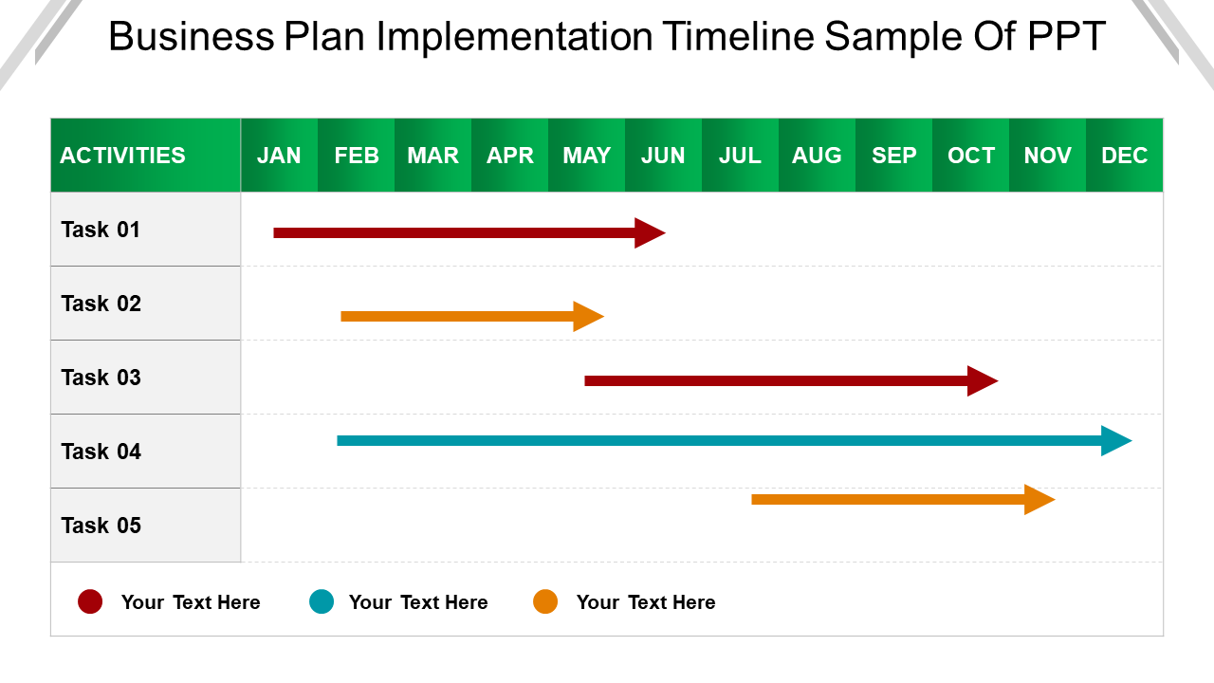

Slide 38
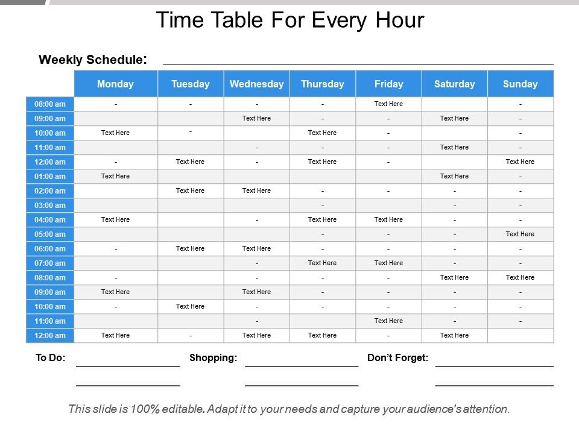

Slide 39
Planning and Scheduling at Work
Planning decides what, how and time estimate for a job.
Scheduling decides when and who will do the job.
Planning of a job should be done before Scheduling a job.
PLANNING
is the key to any successful business, no matter its size.
Planning can help alleviate workplace stress and increase productivity. Rather than plan work for your small business too far in advance, do it daily, modifying your agenda for the next day according to new priorities and unfinished business from the day before. This can help you accomplish goals more efficiently.
Planning is a needed workplace skill, and it is particularly important as person advances into more supervisory or managerial roles. Most work is centered around certain projects that must be completed within a specific time period.

Slide 40
Projects are usually divided into many different tasks, and workers must plan their tasks ahead of time to bring the project to fruition.
A person can also plan ahead in case certain problems come up that could potentially delay the project.
SCHEDULING
A schedule, often called a rota or roster, is a list of employees, and associated information e.g. location, working times, responsibilities for a given time period e.g. week, month or sports season.
A schedule is necessary for the day-to-day operation of many businesses e.g. retail store, manufacturing facility and some offices.
The process of creating a schedule is called scheduling. An effective workplace schedule balances the needs of stakeholders such as management, employees and customers.

Slide 41
A daily schedule is usually ordered chronologically, which means the first employees working that day are listed at the top, followed by the employee who comes in next, etc.
A weekly or monthly schedule is usually ordered alphabetically, employees being listed on the left hand side of a grid, with the days of the week on the top of the grid. In shift work, a schedule usually employs a recurring shift plan.
Scheduling involves allocating a time period for specific tasks or workload, and then assigning tasks to certain employees. For example, small restaurant and retail businesses must be able to schedule the appropriate amount of workers on different days depending on busy times. It is important to account for peak periods when scheduling, Managers must also schedule dates for specific project tasks to be completed. Many small company managers use organizers to stay on track with their assignments.

Slide 42
How to Create a Work Plan
Organization is the key to success in any project. A work plan can help you to stay organized, meet deadlines and complete all the steps involved in your project.
It forces you to plan out every detail.
You can create a work plan for your whole team or a personal work plan for your own project.
Ideally, you work plan should last about six to 12 months, though you can easily make adjustments if you are hitting your deadlines.
Step 1 = Write down the goal of your plan. This should be the ultimate outcome--what you want to accomplish.
Step 2 = Set a goal date for your plan.
Step 3 = Break it down into smaller steps. These are all of the tasks that you need to do in order to complete the project.
Step 4 = Arrange the tasks in the proper order. There are often things that you must do before you can attempt other tasks.

Slide 43
Step 5 = Break your tasks down further. If any of your main tasks have smaller tasks that you need to accomplish, write those down too.
Step 6 = Work backwards from your goal date to set dates for each of your tasks.
For example, the final task before completing your goal should happen a day or two before your goal date; the task before that may happen a week before the goal date.
Step 7 = Schedule each task into your daily and weekly plan. This ensures that you do all of your tasks on time.

Slide 44


Slide 45
Plan and Schedule Your Work at the Work
Step 1 • Make a list of all of the tasks that you need to complete, and break everything down into single days. You don't have to make your list in any order, just write down the necessary tasks as they come to you. This free-flow form of organization will help you remember tasks you might otherwise forget.
Step 2 • Prioritize your list. Now that you know all that needs to be done in the course of the day, start prioritizing your tasks. If necessary, break large tasks down into small ones. Figure out what needs to be done now, what needs to be done before the end of the day and what can be completed another day.
Step 3 • Schedule your day according to your priorities. If you need to finish a project as soon as possible, set aside enough time at the beginning of your day to complete this task. Schedule lesser priorities after lunch or at the close of your business day

Slide 46
Step 4 • Take your work habits into account. Prioritizing and scheduling is one thing, but making that work within your own schedule is an entirely different matter. If you tend to focus better on tasks before lunch, make sure that all of your complicated tasks are completed before this time. If you are more productive an hour before the close of your business day, use this time to get your important tasks done. Understanding how you work can help you be more efficient and increase your productivity.
Step 5 • Write down anything that did not get accomplished during your day, and make it a priority for your next day's list of tasks. While we would all love to finish our to-do lists at the day's end, it is not always possible. Prioritizing the previous day's unfinished tasks will prevent them from getting forgotten as the new day brings new challenges.

Slide 47
AGENCIES TO BE CONTACTED FOR PROJECT IMPLEMENTATION
IMPLEMENTING AGENCY
The implementing agency is responsible for the overall management of the actions that will result in delivery of the materials or services set forth in the Letter of Authority (LOA) that was accepted by a foreign country or international organization.
PROJECT IMPLEMENTING AGENCY
Project Implementing Agency means the responsible agency designated to implement, monitor, and evaluate each city demonstration project under Part 2 of the Project and the term “Project Implementing Agencies” shall refer collectively to every Project Implementing Agency.

Slide 48
Project implementation (or project execution) is the phase where visions and plans become reality. This is the logical conclusion, after evaluating, deciding, visioning, planning, applying for funds and finding the financial resources of a project. Technical implementation is one part of executing a project.
All the payments under the contract for the package for which this invitation for Bids is issued shall be made by the Employer {who is also named as Project Implementing Agency (PIA) by Ministry of Power/GoI} named in Biding Documents.
Gujarat Fibre Grid Network Limited (GFGNL) is inviting bids from the eligible bidders for “Selection of Project Implementing Agency (PIA) for implementation and O&M of Bharat Net Phase-II in state of Gujarat”.

Slide 49
The Project Implementing Agency is supposed to maintain a Financial Management System including adequate accounting and financial reporting, to ensure that it can provide to the World Bank and the Government of India, accurate and timely information regarding the project resources and expenditures.
The Bidding process is designed to select the Project Implementing Agency through a series of technical parameters, giving certain weightage to the technical performance parameters in addition to the financial amounts quoted by the Bidder/ ( or Price discovered through the Reverse Auction process).
Any additional item beyond the Scope of Work required for expansions during the execution period of the Project shall be supplied by the Project Implementing Agency keeping the specifications and unit price same as per the BoQ (Bill of Quantities) and Financial Bid, respectively.

Slide 50
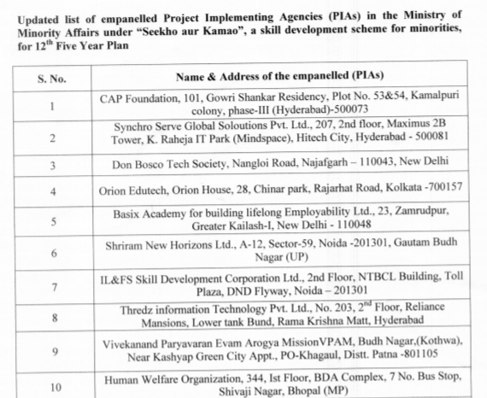

Slide 51
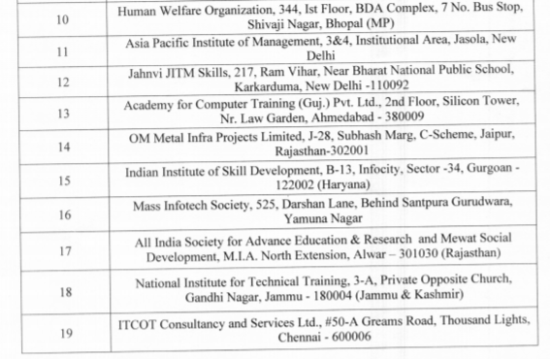

Slide 52
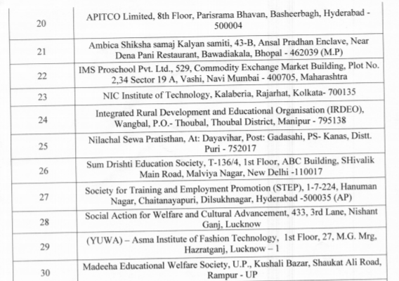

Slide 53
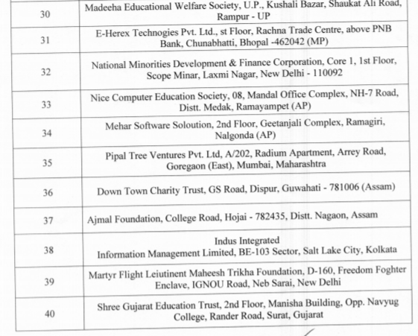

Slide 54
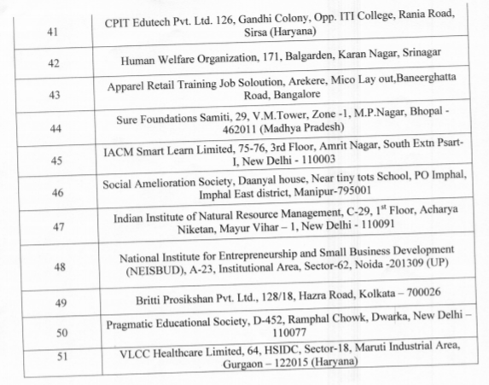

Slide 55
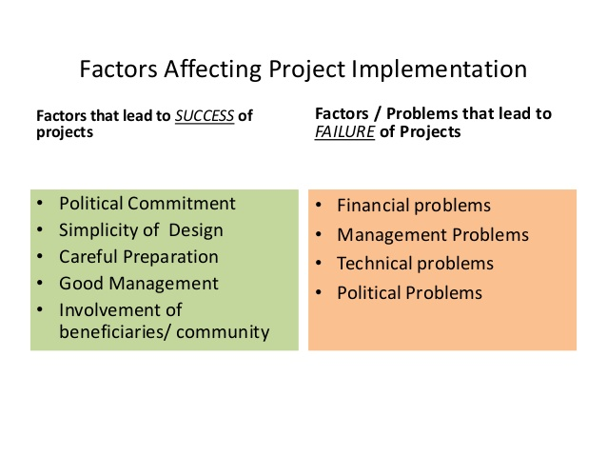

Slide 56
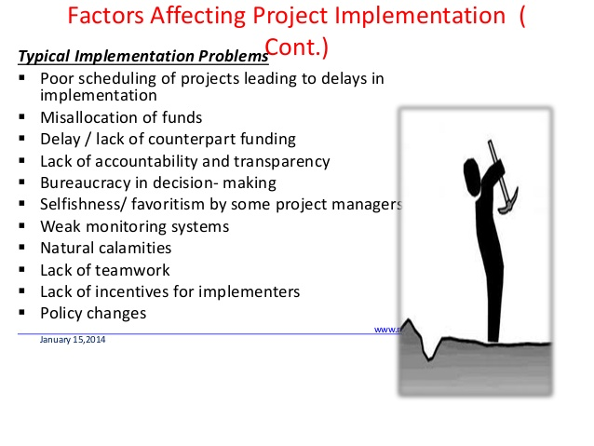

Slide 57
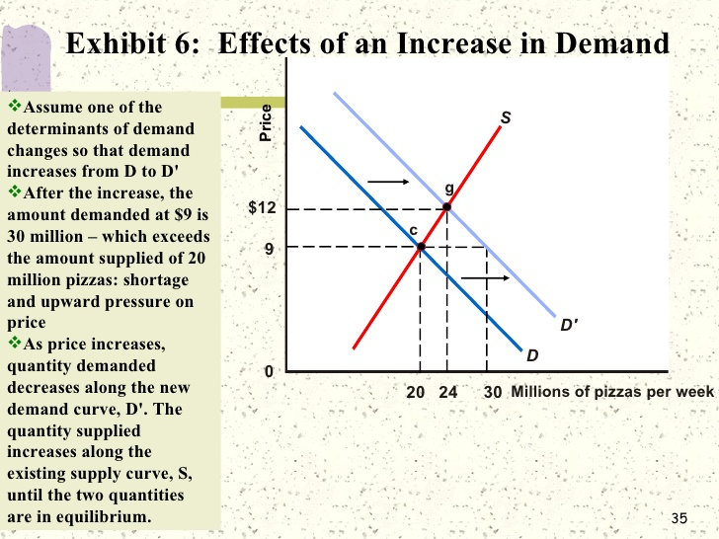

Slide 58
OPPORTUNITIES
Opportunities are a combination of different circumstances at a given time that offer a positive outcome, if taken advantage of.
The key word in this definition is 'circumstances', because opportunities are said to be external.
MARKET OPPORTUNITY IN A BUSINESS PLAN
It's the projected potential size of your market and sales.
Since your market opportunities are essential to the success of your small business, include them in your business plan.
MARKET OPPORTUNITIES
A marketing opportunity is a sales-accepted lead that has been qualified as being in need of your product or service.
A sales representative determines that there is an opportunity to sell to this individual or company.

Slide 59
OPPORTUNITY IDENTIFICATION
Opportunity identification, in fact, is the creative process by which an organization recognizes and assesses such opportunities.
OPPORTUNITY IDENTIFICATION PROCESS
Opportunity Identification process enables groups or individuals to screen a large volume of ideas quickly and methodically.
The process identifies high-potential ideas to rise by allowing weak ideas to fail quickly and inexpensively, on paper instead of in the lab or the real world.

Slide 60
IDENTIFY MARKET OPPORTUNITIES
8 ways to identify opportunities in the market are
Speak to prospects you've lost or potential prospects full stop.
Talk to current customers.
Competitor analysis.
Understand the market.
Explore indirect opportunities.
Look at environmental factors.
Analyze foreign markets.
Investigate other industries.
.

Slide 61
MARKET RESEARCH & DEFINING GOALS
Market research is the process of collecting data about a market, service or product.
It’s used to analyze the current situation and pave the way for a product launch or increased sales.
The market research definition suggests that the study will shed light on the consumer’s habits and needs, the economic shape of the industry and the competitors’ state of affairs.
Its main purpose is to discover a market opportunity for a certain business, and it seems that now a days hardly any concept or rebranding idea can succeed without prior market research.
According to HBR (Harvard Business Review), during the first year, only about 3% of new consumer goods manage to top $50 million in sales, which is considered a success. Meanwhile, only 75% of them reach the $7-million bar.

Slide 62
These numbers clearly reveal a shortage of information about the market.
But the most important fact is that market research is essential not only for new products, but also for existing services and concepts.
If the business wants to scale up sales or introduce a new feature, it requires knowledge on where the clients stand with respect to the current product version and whether they’re ready for changes.
Market research is integral to both launching a new service or supporting and improving the ongoing one.
But before plunging into it, it’s important to define clear market research goals. They might be as follows:

Slide 63
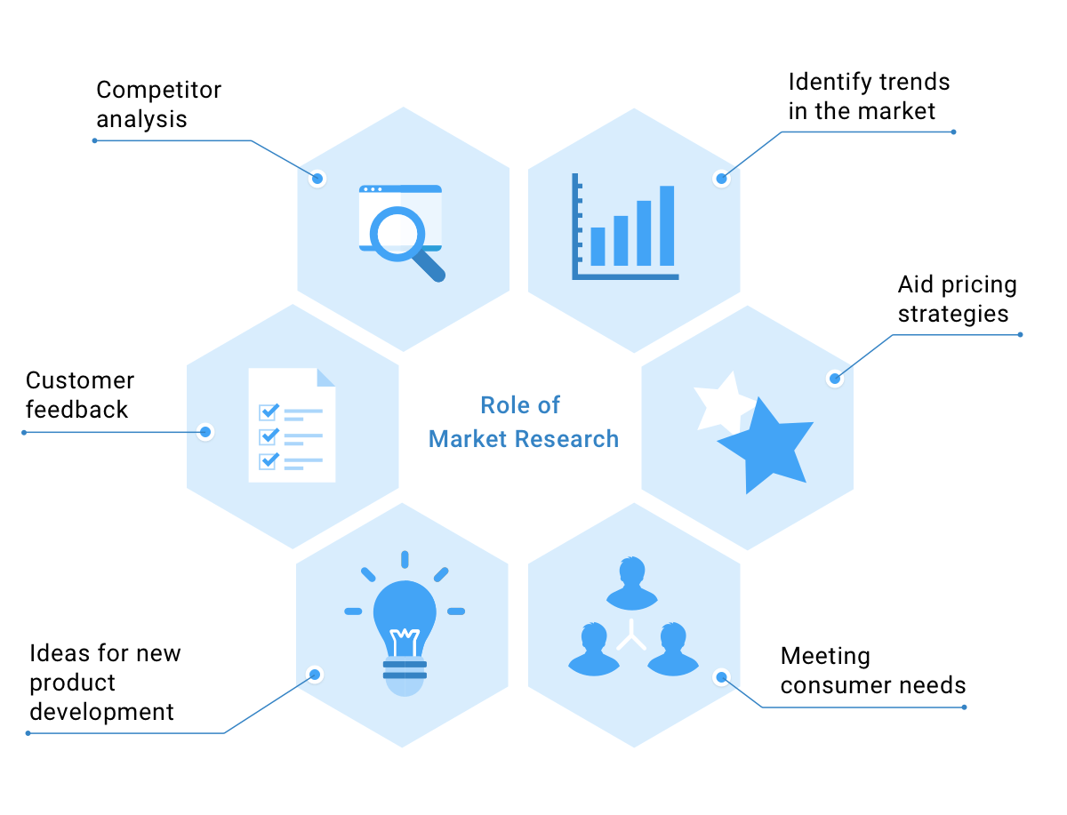

Slide 64
IDENTIFY THE TARGET AUDIENCE
Recognize the peculiarities of local customers’ buying habits.
Explore competitors’ marketing research opportunities and strategies.
Shape the product or service’s identity.
Understand what clients like most/least about the existing product.
Define the true unique selling proposition; Etc.
If you dig deeper into all of the above mentioned sample aims, you’ll see that it’s all about potential or existing clients, and for good reason – they must determine your strategies and plans.

Slide 65
UNDERSTAND YOUR CURRENT CUSTOMERS
It doesn’t matter whether the business concept is new or already popular among customers.
In both cases, looking for market opportunities is an essential part of growth and development.
The only difference is that with existing clients it’s much easier to obtain valuable insights about the target product.
They have used it and gained certain experience with it. And using modern online tools and software, you can easily extract the necessary information.

Slide 66
REVIEW YOUR STATISTICS
If you have a database of clients and use even a basic set of promotional tools, you already have statistical data you can analyze and interpret.
This kind of information is available from:
Google Analytics (see the web traffic sources, visitors’ demographic and geographic stats, etc.)
Social network analytics (Facebook Page Insights, Twitter Analytics, etc.)
YouTube Analytics (check out the customer’s interests and preferences)
Mail Chimp reports (discover open/bounce rates, which texts and links attract more attention, etc.)
This is the first and the easiest step towards understanding customers. But it is surely not the only one.

Slide 67
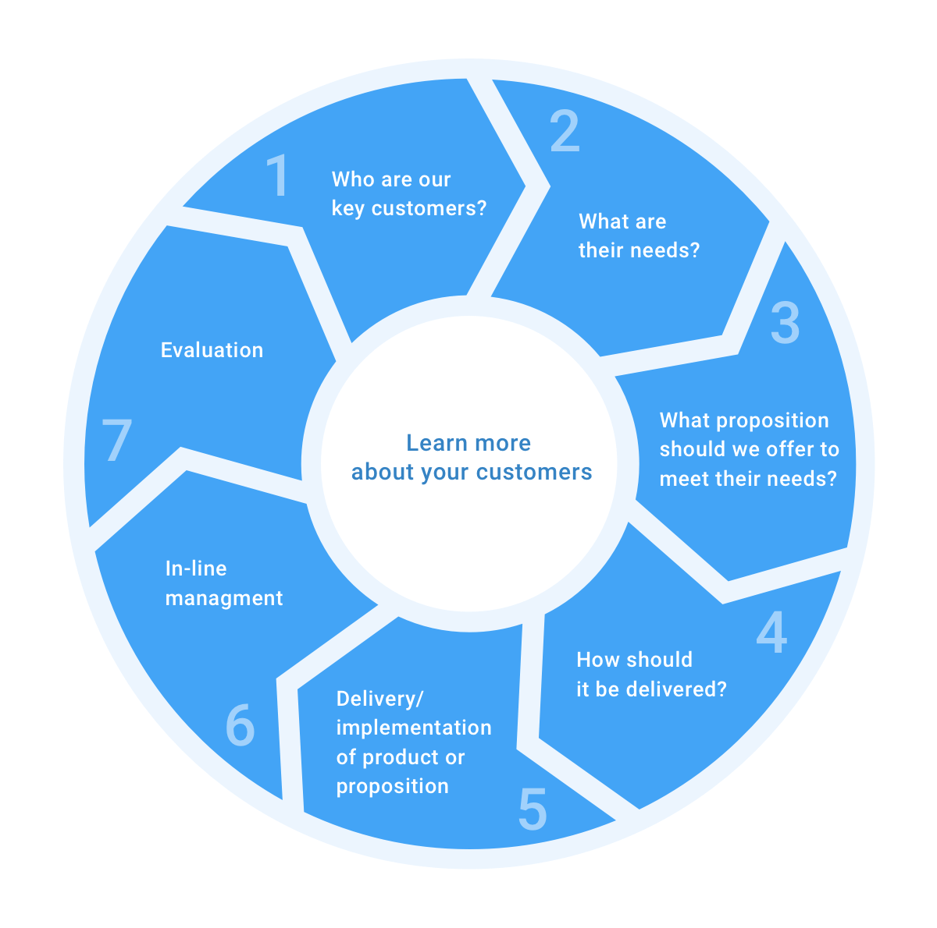

Slide 68
CONDUCT A/B TESTING
After evaluating the statistics, market research methods allow to see the bigger picture and identify weak spots.
If you want to eliminate them and strengthen your marketing, A/B testing can show you the right way to do it.
If you wish to introduce a new feature or refresh the design of your website,
A/B testing gives you an opportunity to learn whether your users will accept the changes before you actually implement them.
You create two or more variations and let people choose which version they like the best.
This is the most efficient way to make a decision at the early stage and save both time and money.

Slide 69
RECORD THE GAPS AND OPPORTUNITIES
It is crucial to make note of all your discoveries, ideas and found opportunities.
Once all of them are written down, you can brainstorm, mind map and discuss potential solutions and strategies with your team.
It is a great advantage to do market research with existing customers.
You just need to access the available information and draw conclusions.
With a new product, the process is a bit more complicated and takes longer, because first you need to collect the data.

Slide 70
COLLECT MARKET INFORMATION
Nowadays, the research can be divided into online studies and “in the wild” exploration.
The majority of businesses opt for the web tools because they are cost-efficient and not resource-intensive, but still produce exhaustive findings.
However, everything should be done step by step. So, before rushing to investigate the best research tools, you need to establish your market first.

Slide 71
DEFINE MARKETS YOU’RE INTERESTED IN
If you pay close attention to, say, Kit Kat, you’ll notice that it greatly adapts to the cultural characteristics of each country where it is presented.
For example, in Japan has the biggest number of Kit Kat flavors (more than 200) because the Japanese are true food experimenters.
Americans and Australians, in turn, have a chance to enjoy the king-size Kit Kat because they are famous for their love for big things (big cars, big houses, etc.).
Given these facts, it’s no wonder that Kit Kat is so successful all over the world.
By defining the markets you are particularly interested in, whether they are local or foreign, you find out more about their specific features.
By taking them into account, it’s possible to create a unique identity for the product and make it stand out among others.

Slide 72
TOOLS FOR COLLECTING MARKET INFORMATION
There are tons of online instruments that allow you to gather as much information as you need.
They mainly can be categorized as:
Free, open-access sources.
These are usually blogs, online magazines or report collections that are available for viewing or downloading at no charge.
The most popular are Think with Google, Hub Spot Research Directory, Pew Research Center, and so on.
Public sources.
can supply valuable data on the current state of business. You can find them at the U.S. Government Printing Office, U.S. Census Bureau or SBA.

Slide 73
Commercial associations.
Here we’re talking about different directories of research datasets collected for specific industries and associations.
They usually have paid subscription membership, but provide high-quality information.
Examples of such resources include the Encyclopedia of Business Information Sources, Encyclopedia of Associations, Dun & Bradstreet, Nielsen Norman Group, etc.
Full–package platforms.
These kinds of companies identify market research process as a whole and take over to deliver the results.
You just provide them with your goals and info you already have, and wait for the findings.
The examples of such platforms are Loop11, Optimizely, Unbounce, etc.

Slide 74
e) Research conducted by educational institutions.
The digital libraries of local colleges/universities may contain many publications with market insights and statistics that can define market opportunities for your product.
It is no longer necessary to spend massive funds and resources to obtain the data you need.
As you can see, the number and variety of online tools has reduced the cost of the process and made it available to all kinds of businesses.

Slide 75
DEFINE YOUR TARGET AUDIENCE
According to the 2017 High Growth Study, about 34% of high-growth companies examine their target audience on a quarterly or more frequent basis.
This gives them the opportunity to multiply their profits and expand their spheres of influence.
These stats prove that the most central subject in your business is your customer – and that the more you know about them, the more chances you have of hitting the big time.

Slide 76
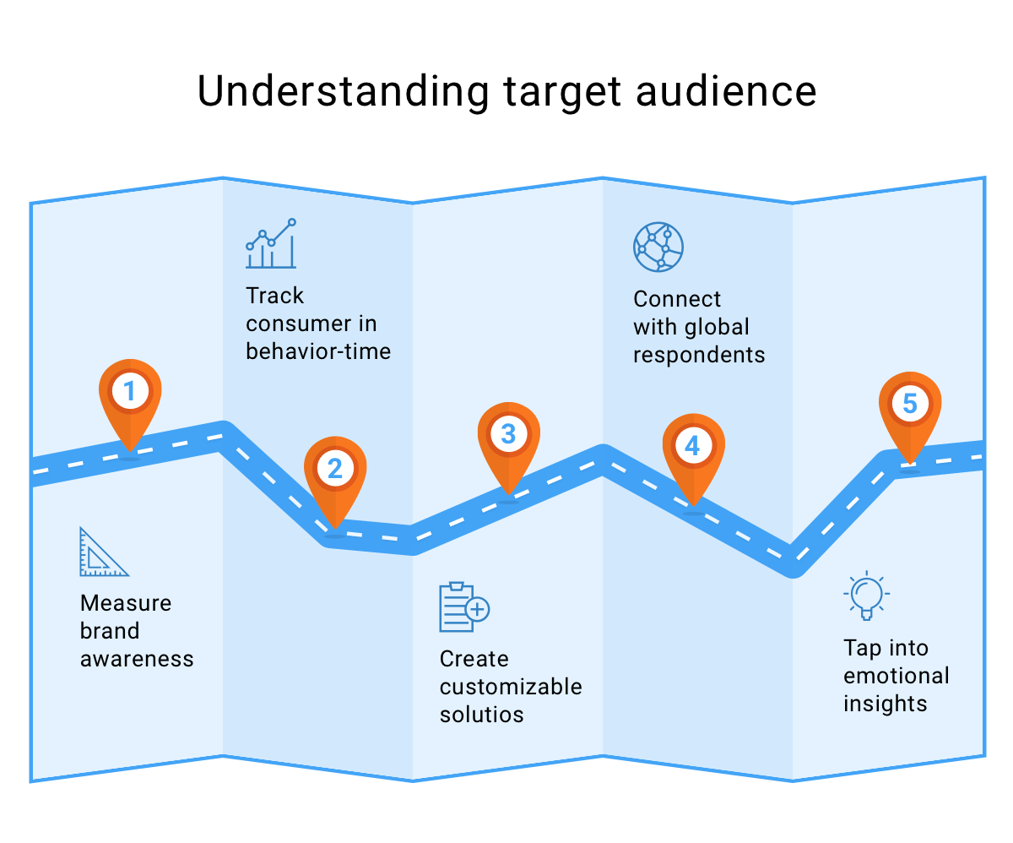

Slide 77
CONDUCT SEO RESEARCH AND IDENTIFY TRENDS
SEO (Search Engine Optimization) research presupposes that you identify the most frequent keywords and phrases that your potential or target audience use to search for information.
This way, it’s possible to determine which problems people have with a certain product or what it lacks.
Most likely you will be also able to see how the users form questions and what language they use.
By applying this information in practice, you’ll be on the same page with your customers.
To gather necessary keywords, take advantage of Google Keyword Planner, Ahrefs or Uber Suggest.
As for trends, usually user’s needs and preferences are tightly connected with the latest tendencies and hype found on Google Trends.

Slide 78
DO AN ONLINE SURVEY
An online survey is one the most powerful UX research tools which you can use to obtain reliable feedback directly from customers.
There are many benefits that make such surveys among the most popular market research instruments.
They are affordable for small and mid-sized business.
Before the launch of a new product, surveys help to determine potential customer preferences which can be used to improve the concept.
They help to measure customer satisfaction with the existing service.
You can test how customers perceive different names/titles.
It’s possible to segment the target audience on the basis of obtained results, Etc.

Slide 79
With modern online possibilities, it is not necessary to organize costly and time-consuming interviews.
Platforms like Survey Monkey, Type Form, Survey Gizmo or Google Survey have a number of features that allow you to create customized polls and distribute them through different channels.
Getting information has never been so easy.
But the questions is: what can you do with it?
Create Customer Segments
After conducting surveys, you may have enough data to divide your target audience into different categories based on age, geography, salary or preferences.
By segmenting your customers, you can create a more personal approach to every customer, and that’s exactly what hooks them to become loyal clients.

Slide 80
The segmentation is also the first step to creating buyer personas, or avatars – that is,
the average customer’s profile, which is widely used in marketing to create individual offers and optimally targeted ad campaigns.
During the whole product design market research process, it is crucial to highlight the ideas you come up with so that later you and your team can turn them into robust market opportunities.
MARKET POTENTIAL & HOW TO DEFINE IT USING DATA
Market potential is a prediction of the overall demand for a certain product at a certain time.
It is always determined before the product launch to gauge whether it is worth investing time and money into the concept at all.
It can be expressed as sales values or sales volumes.
For example, the market potential of a new-edition laptop is $600 000 of yearly profit (sales value) or 100 000 items sold annually (sales volume).

Slide 81
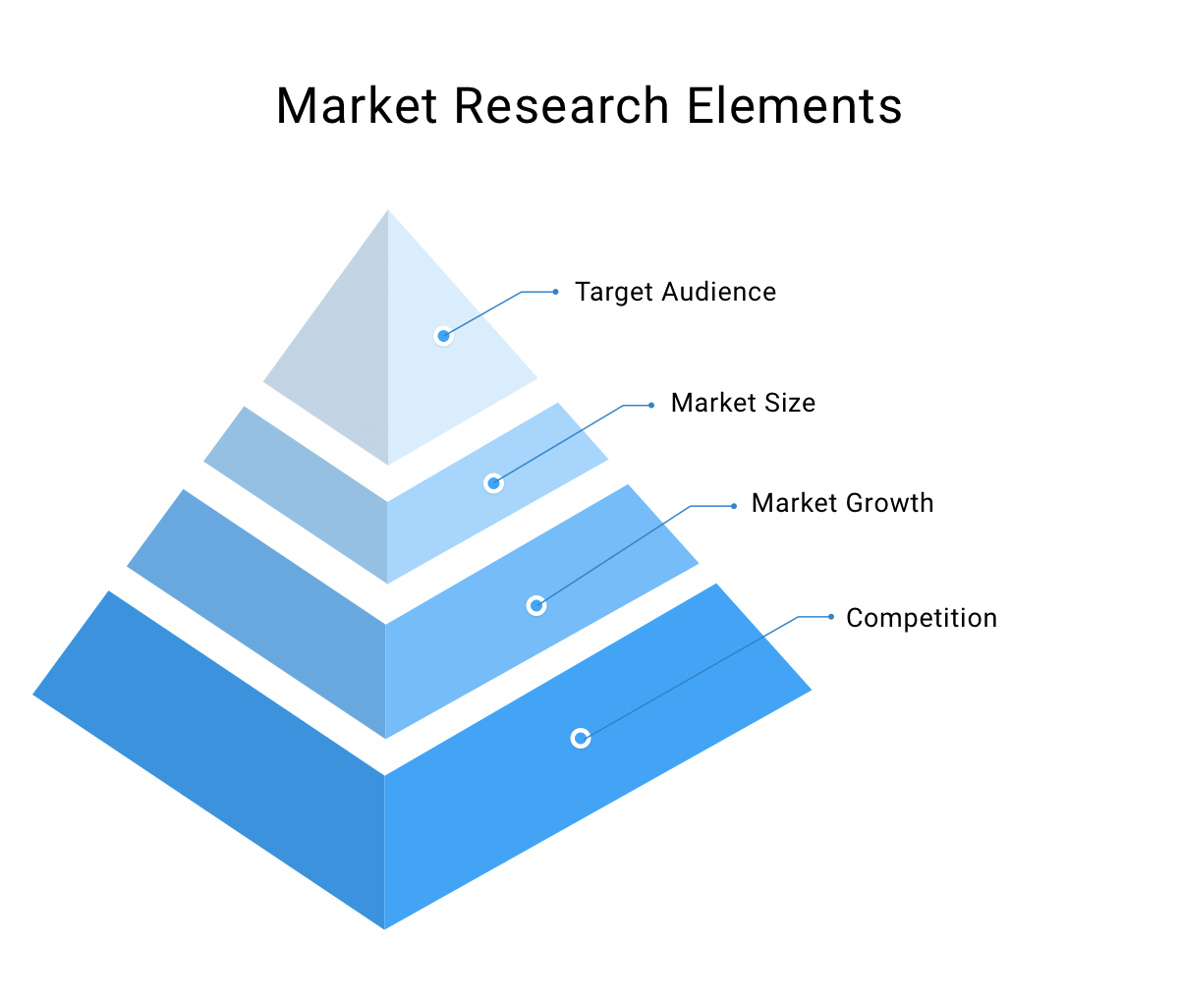

Slide 82
Market potential is tightly connected with market research.
The results of this research – and the following data in particular – are used to work out the total demand for a specific product:
Market size:
Tally the sales of your competitors or try to identify the number of potential customers if your product is new.
The numbers you get will be the approximate market size.
If you are already a market player, you will have your own number.
b) Market growth:
Review figures and facts from the previous 5-10 years in the chosen industry to see whether the market is growing or declining.

Slide 83
Competition:
It is necessary to estimate whether the competition is low or high to forecast which type of launch you have to use, the price you should choose for the product and how much of the promotion will require funds.
Target audience:
This is one of the most important criteria in all stages of product development, especially when you need to identify market opportunities.
By studying your customers, you can get a rough estimate of how often your product will be bought or how much they are willing to pay for your services.
After assessing all these attributes, you’ll come up with numbers that constitute market potential.

Slide 84
Keep in mind that it is not stable, because many factors – like economic conditions – can influence customer buying habits or completely change the trends.
But it is still important, because market potential helps to determine where you should invest resources to get the maximum profit.
It shapes your marketing and communication strategies so you can meet client expectations – and if you do everything right, you will.
Market research generates a great deal of information, but that doesn’t mean you have to use all of it.
Be selective, and use only data relevant to your primary goal, which you will have determined beforehand.
It’s also significant to highlight all the market opportunities that arise in the process to gain maximum benefit from the market studies.
In this case, knowledge is power, so obtain and use it wisely.

Slide 85
FINAL PRODUCT SELECTION
INTRODUCTION TO PRODUCT SELECTION
What is product ?
Product is the bundle of satisfaction.
Product is the conceptual creation of a producer approved by the consumer.
The Philip Kotler is tell the a product is anything that can be offered to a market for attention, acquisition, use or consumption.
This proper definition of product given in “Marketing Management” by Philips kotler.

Slide 86
PRODUCT SELECTION:-
Product selection is the process in which retailor choose the shape or material of the product as per market demand.
Term included in product selection :-
(a) Material (b) Shape (c) Color (d) Price
Demand and Supply Characteristics
(a) Standard products (b) Job-order products
Frequency of Consumption
(a) Fast moving Consumers goods (b) Consumer durable
Nature of use
    (a) Consumers goods (b) Industrial goods
4) Product Characteristics
(a) Product class (b) Product line (c) Product mix

Slide 87
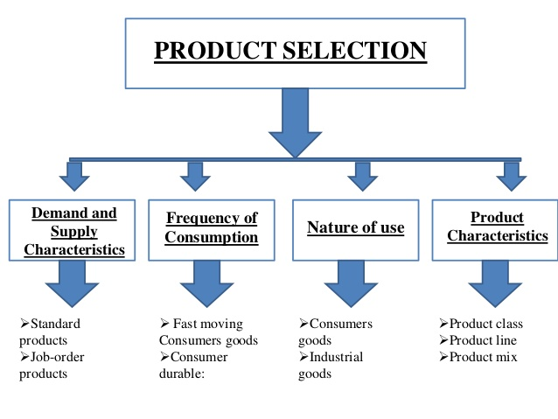

Slide 88
CONCEPT OF PRODUCT SELECTION
Product selection is a decision process, in which the design team selects one or few product concept for further development.
An entrepreneur establishes a business unit with a modest investments in a small scale level.
As he senses business opportunities from the changing environment, keeps on adding, improving and dropping different types of product.
A small business unit progressively becomes large through additional investments.
The new product investment areas are as under:-
(i) Introduction of new product.
(ii) Expansion of the existing product.
(iii) Diversification in a new line of product by an already existing unit.
(iv) Business integration investments- the business is a step-by-step and sequential conversion of raw material into finish product. E.g. a raw cotton is converted into finished cloths through spinning, weaving, and processing.

Slide 89
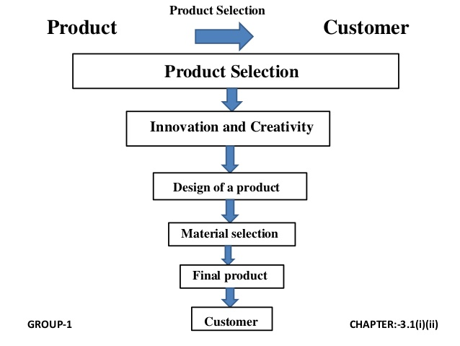

Slide 90
IMPORTANT AVENNUES OF NEW PRODUCT SELECTION
Innovation product, through R & D efforts.
Differentiated imitative product of some existing entrepreneur.
Offensive strategy like sale of joint or by – product for cross subsidizing the main product price-cut.
Defensive strategy through developing self-sufficiency using backward or forward integration.
Joining hand with competitor through collaboration in manufacturing or marketing the products.
Production of components with some large units, e.g. manufacturing of only a component used in scooters, cars, or machinery manufacturing.

Slide 91
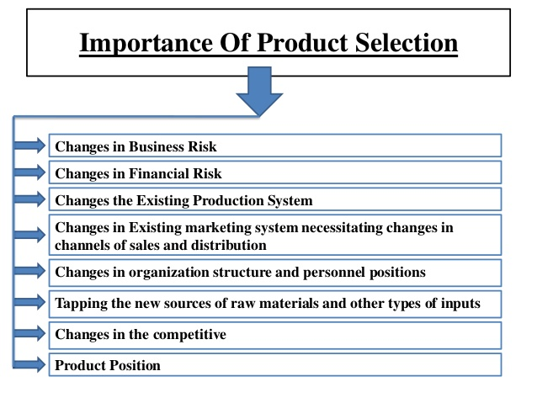

Slide 92


